Slide 1
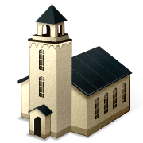
WHY ARE THERE SO MANY CHURCHES?

Slide 2
A denomination is:
a religious organization whose congregations are united in their adherence to its beliefs and practices (Webster)
a group having a distinctive interpretation of a religious faith and usually its own organization (World English Dictionary).
A large group of religious congregations united under a common faith and name, usually organized under a single administrative and legal hierarchy (The American Heritage Dictionary)

Slide 3
"You are the Christ, the Son of the living God” (Mt. 16:16).

Slide 4
Matthew 16:18 "And I also say to you that you are Peter, and on this rock I will build My church, and the gates of Hades shall not prevail against it.

Slide 5
Acts 2:47 And the Lord added to the church daily those who were being saved.

Slide 6
Acts 20:28 "Therefore take heed to yourselves and to all the flock, among which the Holy Spirit has made you overseers, to shepherd the church of God which He purchased with His own blood.

Slide 7
Ephesians 1:22 And He put all things under His feet, and gave Him to be head over all things to the church, ²³ which is His body,
Same Thing

Slide 8
Ephesians 4:4 There is one body and one Spirit, just as you were called in one hope of your calling;

Slide 9
Ephesians 5:23 …and He is the Savior of the body.

Slide 10
2 Timothy 4:2 Preach the word! Be ready in season and out of season. Convince, rebuke, exhort, with all longsuffering and teaching. ³ For the time will come when they will not endure sound doctrine, but according to their own desires, because they have itching ears, they will heap up for themselves teachers; ⁴ and they will turn their ears away from the truth, and be turned aside to fables.

Slide 11
1 Timothy 4:1 Now the Spirit expressly says that in latter times some will depart from the faith, giving heed to deceiving spirits and doctrines of demons, ² speaking lies in hypocrisy, having their own conscience seared with a hot iron, ³ forbidding to marry, and commanding to abstain from foods which God created to be received with thanksgiving by those who believe and know the truth.

Slide 12
Why are there so many churches today?
It is because of man’s desire to be different and have things his way or to be like everyone else.

Slide 13
1 Timothy 4:1 Now the Spirit expressly says that in latter times some will depart from the faith, giving heed to deceiving spirits and doctrines of demons, ² speaking lies in hypocrisy, having their own conscience seared with a hot iron, ³ forbidding to marry, and commanding to abstain from foods which God created to be received with thanksgiving by those who believe and know the truth.

Slide 14
Acts 20:29 "For I know this, that after my departure savage wolves will come in among you, not sparing the flock. ³⁰ "Also from among yourselves men will rise up, speaking perverse things, to draw away the disciples after themselves. ³¹ "Therefore watch, and remember that for three years I did not cease to warn everyone night and day with tears.

Slide 15
Genesis 3:4 Then the serpent said to the woman, "You will not surely die. ⁵ "For God knows that in the day you eat of it your eyes will be opened, and you will be like God, knowing good and evil." ⁶ So when the woman saw that the tree was good for food, that it was pleasant to the eyes, and a tree desirable to make one wise, she took of its fruit and ate. She also gave to her husband with her, and he ate.

Slide 16
1 Kings 11:31-35
1 Kings 11:38 'Then it shall be, if you heed all that I command you, walk in My ways, and do what is right in My sight, to keep My statutes and My commandments, as My servant David did, then I will be with you and build for you an enduring house, as I built for David, and will give Israel to you.

Slide 17
1 Kings 12:25 Then Jeroboam built Shechem in the mountains of Ephraim, and dwelt there. Also he went out from there and built Penuel. ²⁶ And Jeroboam said in his heart, "Now the kingdom may return to the house of David: ²⁷ "If these people go up to offer sacrifices in the house of the LORD at Jerusalem, then the heart of this people will turn back to their lord, Rehoboam king of Judah, and they will kill me and go back to Rehoboam king of Judah." ²⁸ Therefore the king asked advice, made two calves of gold, and said to the people, "It is too much for you to go up to Jerusalem. Here are your gods, O Israel, which brought you up from the land of Egypt!"

Slide 18
²⁹ And he set up one in Bethel, and the other he put in Dan. ³⁰ Now this thing became a sin, for the people went to worship before the one as far as Dan. ³¹ He made shrines on the high places, and made priests from every class of people, who were not of the sons of Levi. ³² Jeroboam ordained a feast on the fifteenth day of the eighth month, like the feast that was in Judah, and offered sacrifices on the altar. So he did at Bethel, sacrificing to the calves that he had made. And at Bethel he installed the priests of the high places which he had made.

Slide 19
³³ So he made offerings on the altar which he had made at Bethel on the fifteenth day of the eighth month, in the month which he had devised in his own heart. And he ordained a feast for the children of Israel, and offered sacrifices on the altar and burned incense.

Slide 20
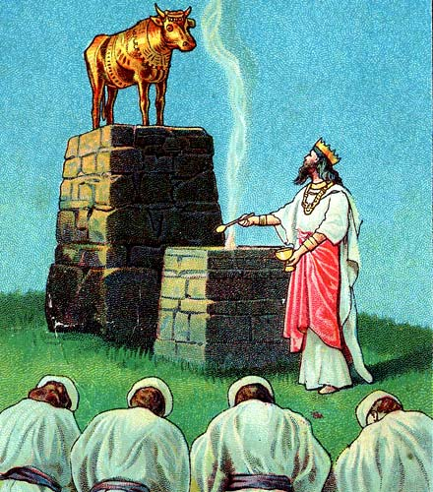

Slide 21
1 Corinthians 1:10 Now I plead with you, brethren, by the name of our Lord Jesus Christ, that you all speak the same thing, and that there be no divisions among you, but that you be perfectly joined together in the same mind and in the same judgment. ¹¹ For it has been declared to me concerning you, my brethren, by those of Chloe's household, that there are contentions among you. ¹² Now I say this, that each of you says, "I am of Paul," or "I am of Apollos," or "I am of Cephas," or "I am of Christ." ¹³ Is Christ divided? Was Paul crucified for you? Or were you baptized in the name of Paul?

Slide 22
¹³ Is Christ divided? Was Paul crucified for you? Or were you baptized in the name of Paul?

Slide 23
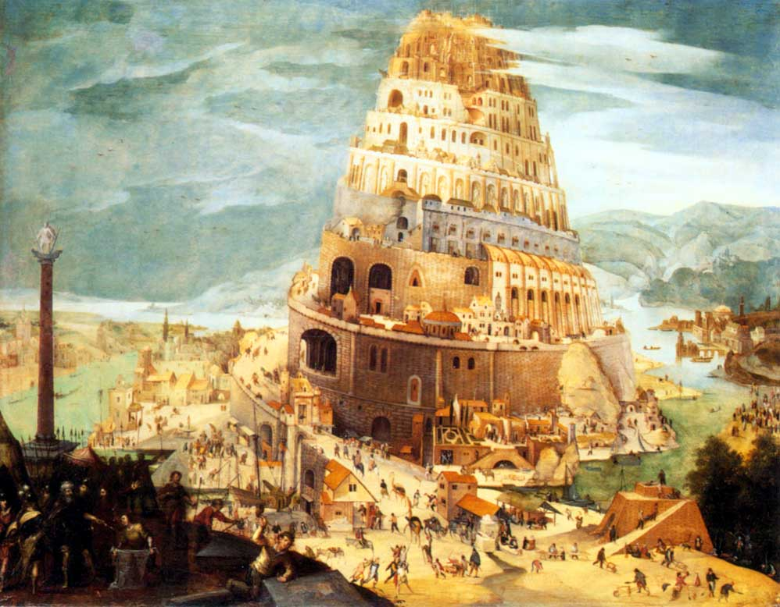

Slide 24
What we have learned so far:
The Scriptures teach that Jesus built one church.
The Scriptures teach that some would depart from the church by departing from the teaching of the New Testament.
The reason we have so many churches/denominations today is because of man’s desire to do things his way instead of God’s way.

Slide 26
The Gnostics (A.D. 125) were those who believed that salvation came by special knowledge through Gnostic teachers. They had many strange beliefs and were far from being anything close to the N.T. church.

Slide 27
The Montanists (A.D. 156) were a group that was started by a man named Montanus who claimed to be a prophet of God and claimed that the Holy Spirit was revealing revelations to him. He taught others that they could receive revelations as well if they would fast and pray. From these suppposed revelations came new teachings and twists on Scripture.

Slide 28
The Manicheans (A.D. 244) were a group started by a man named Mani. His teachings focused on the struggles between good and evil, but he denied that God was omnipotent.

Slide 30
In the early 300’s, Constantine took an interest in the church and he ended the persecution of Christians in A.D. 313.

Slide 31
Catholic Church

Slide 32
Latin Mass A.D. 394
Purgatory Doctrine A.D. 593
The First Official Pope who was called “God on earth” A.D. 606
Transubstantiation Doctrine A.D. 1000
Celibacy of Priest mandated A.D. 1015

Slide 33
For the first 1000 years there were two churches. There was the one that Jesus built and there was this manmade church, the Catholic church.

Slide 34
Indulgences A.D. 1192
Taking Confessions A.D. 1215
Sprinkling replaced immersion for baptism A.D. 1311
The Pope is declared infallible A.D. 1870

Slide 36
Matthew 7:21 " Not everyone who says to Me, 'Lord, Lord,' shall enter the kingdom of heaven, but he who does the will of My Father in heaven. ²² "Many will say to Me in that day, 'Lord, Lord, have we not prophesied in Your name, cast out demons in Your name, and done many wonders in Your name?' ²³ "And then I will declare to them, 'I never knew you; depart from Me, you who practice lawlessness!'

Slide 37
Ephesians 5:23 … Christ is head of the church; and He is the Savior of the body.

Slide 38
How can we make sure we are part of the body of Christ and will be saved?

Slide 39
2 Thessalonians 1:7 and to give you who are troubled rest with us when the Lord Jesus is revealed from heaven with His mighty angels, ⁸ in flaming fire taking vengeance on those who do not know God, and on those who do not obey the gospel of our Lord Jesus Christ.

Slide 40
Romans 10:14 How then shall they call on Him in whom they have not believed? And how shall they believe in Him of whom they have not heard? And how shall they hear without a preacher?

Slide 41
Romans 10:17 So then faith comes by hearing, and hearing by the word of God.

Slide 42
James 2:24 You see then that a man is justified by works, and not by faith only.

Slide 43
Luke 13:3 "I tell you, no; but unless you repent you will all likewise perish.

Slide 44
Romans 10:9 that if you confess with your mouth the Lord Jesus and believe in your heart that God has raised Him from the dead, you will be saved.

Slide 45
Baptism is for the forgiveness of sin:
Acts 2:38 Then Peter said to them, "Repent, and let every one of you be baptized in the name of Jesus Christ for the remission of sins;

Slide 46
Jesus says that baptism saves:
Mark 16:16 "He who believes and is baptized will be saved; but he who does not believe will be condemned.

Slide 47
Baptism is when we are buried with Christ and put into Christ:
Romans 6:3 Or do you not know that as many of us as were baptized into Christ Jesus were baptized into His death?
Galatians 3:27 For as many of you as were baptized into Christ have put on Christ.

Slide 48
Baptism is the point we are added to the one church/kingdom of God:
John 3:5 Jesus answered, "Most assuredly, I say to you, unless one is born of water and the Spirit, he cannot enter the kingdom of God.
1 Corinthians 12:13 For by one Spirit we were all baptized into one body

Slide 49
Those 3000 souls that obeyed the gospel on the Day of Pentecost in Acts 2 who were baptized for the forgiveness of their sins were added to the church by God:
Acts 2:47 … And the Lord added to the church daily those who were being saved.

Slide 50
We cannot belong to the church that Jesus built until we obey the gospel, which means we must hear, believe, repent, confess Jesus as our Lord, and be baptized for the forgiveness of our sins.

Slide 51
Revelation 2:10 … Be faithful until death, and I will give you the crown of life.

