Slide 1
WHAT ARE THE GREATEST THINGS OF LIFE?
PART 3

Slide 2
1. Love
2. Our greatest purpose in life is to glorify our Father in heaven in everything that we do.
3. The greatest privileges we have in this life is the honor of being children of God.
4. The greatest knowledge of this life is to know God through His Word.
5. There is no greater vocation (main calling in life) in this life than serving God in every way that we can.

Slide 3
Proverbs 11:30 The fruit of the righteous is a tree of life, And he who wins souls is wise.

Slide 4
Daniel 12:1 "At that time Michael shall stand up, The great prince who stands watch over the sons of your people; And there shall be a time of trouble, Such as never was since there was a nation, Even to that time. And at that time your people shall be delivered, Every one who is found written in the book. ² And many of those who sleep in the dust of the earth shall awake, Some to everlasting life, Some to shame and everlasting contempt. ³ Those who are wise shall shine Like the brightness of the firmament, And those who turn many to righteousness Like the stars forever and ever.

Slide 5
Luke 15:3 So He spoke this parable to them, saying: ⁴ "What man of you, having a hundred sheep, if he loses one of them, does not leave the ninety-nine in the wilderness, and go after the one which is lost until he finds it? ⁵ "And when he has found it, he lays it on his shoulders, rejoicing. ⁶ "And when he comes home, he calls together his friends and neighbors, saying to them, 'Rejoice with me, for I have found my sheep which was lost!' ⁷ "I say to you that likewise there will be more joy in heaven over one sinner who repents than over ninety-nine just persons who need no repentance.

Slide 6
⁸ " Or what woman, having ten silver coins, if she loses one coin, does not light a lamp, sweep the house, and search carefully until she finds it? ⁹ "And when she has found it, she calls her friends and neighbors together, saying, 'Rejoice with me, for I have found the piece which I lost!' ¹⁰ "Likewise, I say to you, there is joy in the presence of the angels of God over one sinner who repents."

Slide 7
2 Peter 2:20 For if, after they have escaped the pollutions of the world through the knowledge of the Lord and Savior Jesus Christ, they are again entangled in them and overcome, the latter end is worse for them than the beginning. ²¹ For it would have been better for them not to have known the way of righteousness, than having known it, to turn from the holy commandment delivered to them. ²² But it has happened to them according to the true proverb: "A dog returns to his own vomit," and, "a sow, having washed, to her wallowing in the mire."

Slide 8
Galatians 6:1 Brethren, if a man is overtaken in any trespass, you who are spiritual restore such a one in a spirit of gentleness, considering yourself lest you also be tempted.

Slide 9
2 Corinthians 5:9Therefore we make it our aim, whether present or absent, to be well pleasing to Him. ¹⁰ For we must all appear before the judgment seat of Christ, that each one may receive the things done in the body, according to what he has done, whether good or bad. ¹¹ Knowing, therefore, the terror of the Lord, we persuade men;

Slide 10
Matthew 7:13 " Enter by the narrow gate; for wide is the gate and broad is the way that leads to destruction, and there are many who go in by it. ¹⁴ "Because narrow is the gate and difficult is the way which leads to life, and there are few who find it.

Slide 11
Though we may win many battles in this life, let us not become over confident in our victories because we are fighting a war that will not end for us until the day we die.

Slide 12
1 John 5:2 By this we know that we love the children of God, when we love God and keep His commandments. ³ For this is the love of God, that we keep His commandments. And His commandments are not burdensome. ⁴ For whatever is born of God overcomes the world. And this is the victory that has overcome the world -- our faith. ⁵ Who is he who overcomes the world, but he who believes that Jesus is the Son of God?

Slide 13
1 John 2:14 I have written to you, fathers, Because you have known Him who is from the beginning. I have written to you, young men, Because you are strong, and the word of God abides in you, And you have overcome the wicked one.

Slide 14
Revelation 3:5 "He who overcomes shall be clothed in white garments, and I will not blot out his name from the Book of Life; but I will confess his name before My Father and before His angels.

Slide 15
Matthew 16:26 "For what profit is it to a man if he gains the whole world, and loses his own soul? Or what will a man give in exchange for his soul?

Slide 16
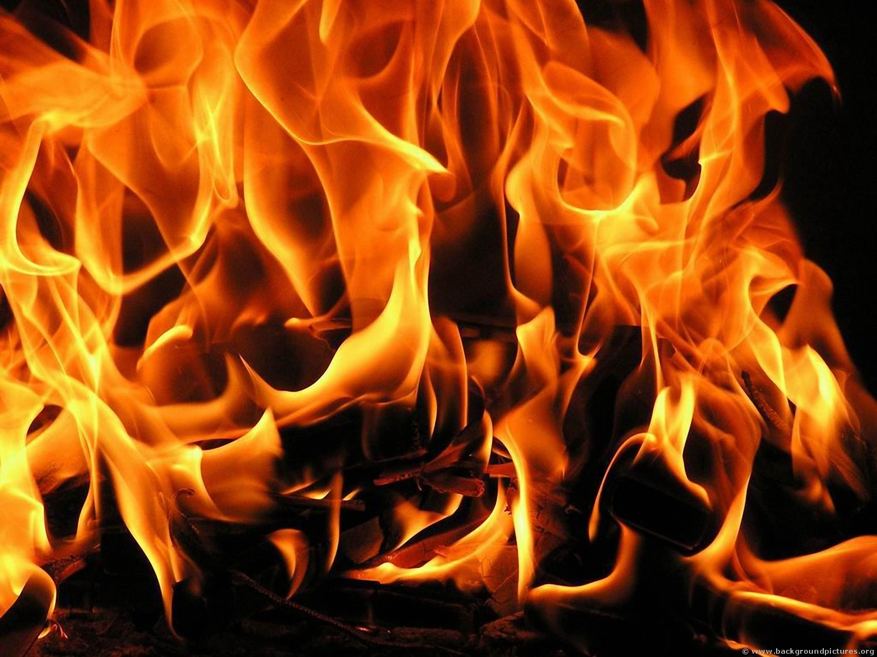
Mark 9:47 "And if your eye causes you to sin, pluck it out. It is better for you to enter the kingdom of God with one eye, rather than having two eyes, to be cast into hell fire -- ⁴⁸ "where 'Their worm does not die, And the fire is not quenched.'

Slide 17
Matthew 10:28 "And do not fear those who kill the body but cannot kill the soul. But rather fear Him who is able to destroy both soul and body in hell.
2 Thessalonians 1:7 and to give you who are troubled rest with us when the Lord Jesus is revealed from heaven with His mighty angels, ⁸ in flaming fire taking vengeance on those who do not know God, and on those who do not obey the gospel of our Lord Jesus Christ. ⁹ These shall be punished with everlasting destruction from the presence of the Lord and from the glory of His power,

Slide 18
Matthew 8:12 "But the sons of the kingdom will be cast out into outer darkness. There will be weeping and gnashing of teeth."

Slide 19
Matthew 25:41 "Then He will also say to those on the left hand, 'Depart from Me, you cursed, into the everlasting fire prepared for the devil and his angels: ⁴² 'for I was hungry and you gave Me no food; I was thirsty and you gave Me no drink; ⁴³ 'I was a stranger and you did not take Me in, naked and you did not clothe Me, sick and in prison and you did not visit Me.' ⁴⁴ "Then they also will answer Him, saying, 'Lord, when did we see You hungry or thirsty or a stranger or naked or sick or in prison, and did not minister to You?' ⁴⁵ "Then He will answer them, saying, 'Assuredly, I say to you, inasmuch as you did not do it to one of the least of these, you did not do it to Me.' ⁴⁶ "And these will go away into everlasting punishment, but the righteous into eternal life."

Slide 20
2 Corinthians 4:17 For our light affliction, which is but for a moment, is working for us a far more exceeding and eternal weight of glory, ¹⁸ while we do not look at the things which are seen, but at the things which are not seen. For the things which are seen are temporary, but the things which are not seen are eternal.

Slide 21
Hebrews 12:1 Therefore we also, since we are surrounded by so great a cloud of witnesses, let us lay aside every weight, and the sin which so easily ensnares us, and let us run with endurance the race that is set before us, ² looking unto Jesus, the author and finisher of our faith, who for the joy that was set before Him endured the cross, despising the shame, and has sat down at the right hand of the throne of God.

Slide 22
1 Corinthians 9:24 Do you not know that those who run in a race all run, but one receives the prize? Run in such a way that you may obtain it. ²⁵ And everyone who competes for the prize is temperate in all things. Now they do it to obtain a perishable crown, but we for an imperishable crown.

Slide 23
Galatians 6:7 Do not be deceived, God is not mocked; for whatever a man sows, that he will also reap. ⁸ For he who sows to his flesh will of the flesh reap corruption, but he who sows to the Spirit will of the Spirit reap everlasting life. ⁹ And let us not grow weary while doing good, for in due season we shall reap if we do not lose heart.

Slide 24
1 Timothy 6:12 Fight the good fight of faith, lay hold on eternal life, to which you were also called and have confessed the good confession in the presence of many witnesses.

Slide 25
2 Timothy 4:7 I have fought the good fight, I have finished the race, I have kept the faith. ⁸ Finally, there is laid up for me the crown of righteousness, which the Lord, the righteous Judge, will give to me on that Day, and not to me only but also to all who have loved His appearing.

