Slide 1
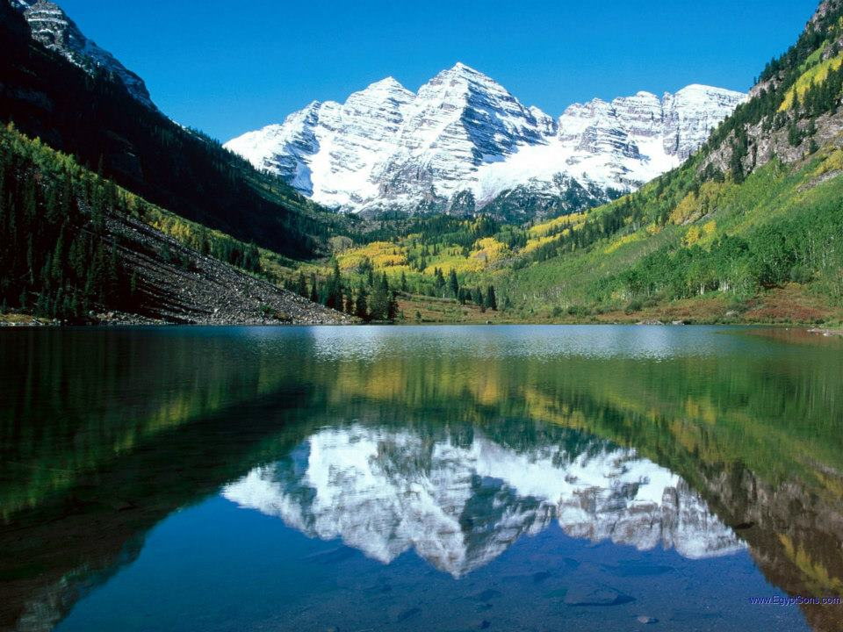
WAKE UP
AND
LIVE
FOR GOD
Part 1

Slide 2

John 10:7 Then Jesus said to them again, "Most assuredly, I say to you, I am the door of the sheep. ⁸ "All who ever came before Me are thieves and robbers, but the sheep did not hear them. ⁹ "I am the door. If anyone enters by Me, he will be saved, and will go in and out and find pasture. ¹⁰ "The thief does not come except to steal, and to kill, and to destroy. I have come that they may have life, and that they may have it more abundantly.

Slide 3
Ephesians 5:14 Therefore He says: "Awake, you who sleep, Arise from the dead, And Christ will give you light."

Slide 4
Revelation 3:1 "And to the angel of the church in Sardis write, ' These things says He who has the seven Spirits of God and the seven stars: "I know your works, that you have a name that you are alive, but you are dead. ² "Be watchful, and strengthen the things which remain, that are ready to die, for I have not found your works perfect before God. ³ "Remember therefore how you have received and heard; hold fast and repent. Therefore if you will not watch, I will come upon you as a thief, and you will not know what hour I will come upon you.

Slide 5
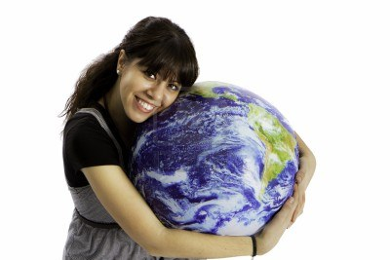
Christians who have fallen away because they have allowed themselves to get wrapped up in the pleasures of this world.

Slide 6
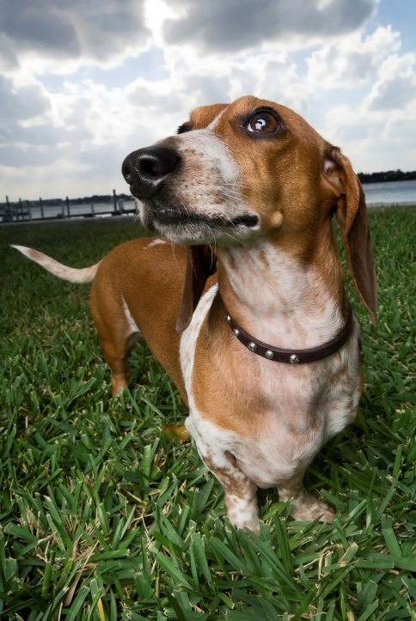
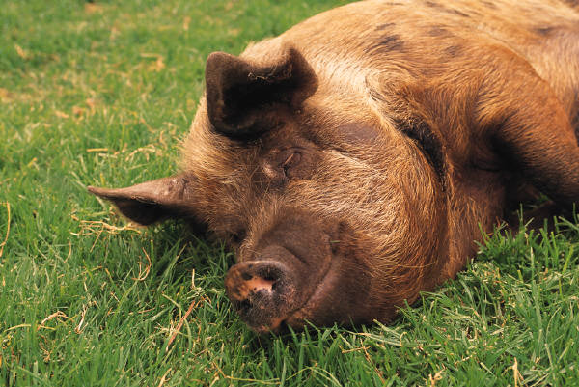
2 Peter 2:20 For if, after they have escaped the pollutions of the world through the knowledge of the Lord and Savior Jesus Christ, they are again entangled in them and overcome, the latter end is worse for them than the beginning. ²¹ For it would have been better for them not to have known the way of righteousness, than having known it, to turn from the holy commandment delivered to them. ²² But it has happened to them according to the true proverb: "A dog returns to his own vomit," and, "a sow, having washed, to her wallowing in the mire."

Slide 7
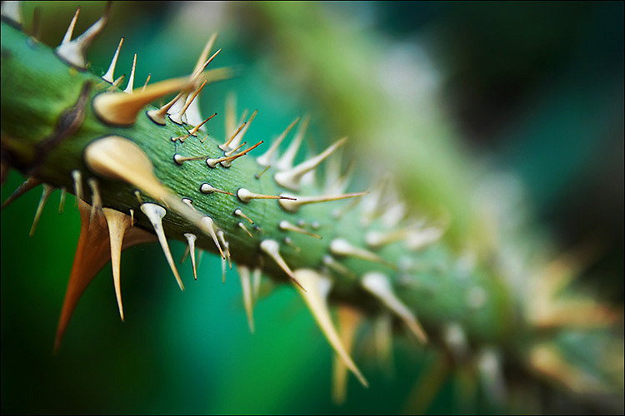
Luke 8:14 "Now the ones that fell among thorns are those who, when they have heard, go out and are choked with cares, riches, and pleasures of life, and bring no fruit to maturity.

Slide 8
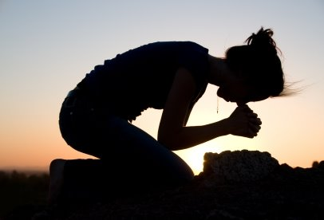
1 Timothy 5:5 Now she who is really a widow, and left alone, trusts in God and continues in supplications and prayers night and day. ⁶ But she who lives in pleasure is dead while she lives.

Slide 9
Romans 6:23 For the wages of sin is death…

Slide 10
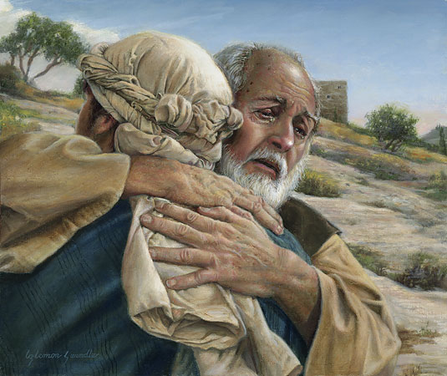
Luke 15:17 "But when he came to himself, he said, 'How many of my father's hired servants have bread enough and to spare, and I perish with hunger! ¹⁸ 'I will arise and go to my father, and will say to him, "Father,
I have sinned against heaven and before you, ¹⁹ "and I am no longer worthy to be called your son. Make me like one of your hired servants." ' ²⁰ "And he arose and came to his father. But when he was still a great way off, his father saw him and had compassion, and ran and fell on his neck and kissed him.

Slide 11
²¹ "And the son said to him, 'Father, I have sinned against heaven and in your sight, and am no longer worthy to be called your son.' ²² "But the father said to his servants, 'Bring out the best robe and put it on
him, and put a ring on his hand and sandals on his feet. ²³ 'And bring the fatted calf here and kill it, and let us eat and be merry; ²⁴ 'for this my son was dead and is alive again; he was lost and is found.' And they began to be merry.

Slide 12
Hebrews 11:24 By faith Moses, when he became of age, refused to be called the son of Pharaoh's daughter, ²⁵ choosing rather to suffer affliction with the people of God than to enjoy the passing pleasures of sin, ²⁶ esteeming the reproach of Christ greater riches than the treasures in Egypt; for he looked to the reward. ²⁷ By faith he forsook Egypt, not fearing the wrath of the king; for he endured as seeing Him who is invisible.

Slide 13
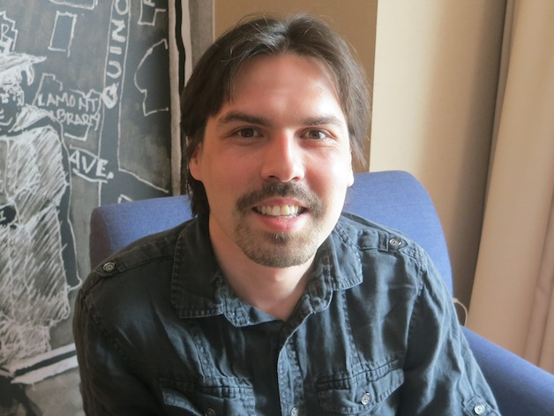
Those who have never obeyed the gospel.

Slide 14
Ephesians 2:1 And you He made alive, who were dead in trespasses and sins, ² in which you once walked according to the course of this world, according to the prince of the power of the air, the spirit who now works in the sons of disobedience, ³ among whom also we all once conducted ourselves in the lusts of our flesh, fulfilling the desires of the flesh and of the mind, and were by nature children of wrath, just as the others. ⁴ But God, who is rich in mercy, because of His great love with which He loved us, ⁵ even when we were dead in trespasses, made us alive together with Christ (by grace you have been saved),

Slide 15
Ephesians 2:8 For by grace you have been saved through faith, and that not of yourselves; it is the gift of God, ⁹ not of works, lest anyone should boast.

Slide 16
Joshua 6:1 Now Jericho was securely shut up because of the children of Israel; none went out, and none came in. ² And the LORD said to Joshua: "See! I have given Jericho into your hand, its king, and the mighty men of valor.

Slide 17
Joshua 6:3 "You shall march around the city, all you men of war; you shall go all around the city once. This you shall do six days. ⁴ "And seven priests shall bear seven trumpets of rams' horns before the ark. But the seventh day you shall march around the city seven times, and the priests shall blow the trumpets. ⁵ "It shall come to pass, when they make a long blast with the ram's horn, and when you hear the sound of the trumpet, that all the people shall shout with a great shout; then the wall of the city will fall down flat. And the people shall go up every man straight before him."

Slide 18
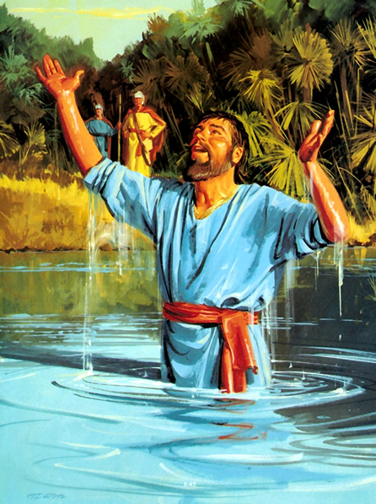
Naaman in 2 Kings 5

Slide 19
James 2:14 What does it profit, my brethren, if someone says he has faith but does not have works? Can faith save him? ¹⁵ If a brother or sister is naked and destitute of daily food, ¹⁶ and one of you says to them, "Depart in peace, be warmed and filled," but you do not give them the things which are needed for the body, what does it profit? ¹⁷ Thus also faith by itself, if it does not have works, is dead. ¹⁸ But someone will say, "You have faith, and I have works." Show me your faith without your works, and I will show you my faith by my works. ¹⁹ You believe that there is one God. You do well. Even the demons believe -- and tremble! ²⁰ But do you want to know, O foolish man, that faith without works is dead?

Slide 20
²¹ Was not Abraham our father justified by works when he offered Isaac his son on the altar? ²² Do you see that faith was working together with his works, and by works faith was made perfect? ²³ And the Scripture was fulfilled which says, "Abraham believed God, and it was accounted to him for righteousness." And he was called the friend of God. ²⁴ You see then that a man is justified by works, and not by faith only. ²⁵ Likewise, was not Rahab the harlot also justified by works when she received the messengers and sent them out another way? ²⁶ For as the body without the spirit is dead, so faith without works is dead also.

Slide 21
Matthew 7:21 " Not everyone who says to Me, 'Lord, Lord,' shall enter the kingdom of heaven, but he who does the will of My Father in heaven. ²² "Many will say to Me in that day, 'Lord, Lord, have we not prophesied in Your name, cast out demons in Your name, and done many wonders in Your name?' ²³ "And then I will declare to them, 'I never knew you; depart from Me, you who practice lawlessness!' ²⁴ " Therefore whoever hears these sayings of Mine, and does them, I will liken him to a wise man who built his house on the rock:

Slide 22
²⁵ "and the rain descended, the floods came, and the winds blew and beat on that house; and it did not fall, for it was founded on the rock. ²⁶ "But everyone who hears these sayings of Mine, and does not do them, will be like a foolish man who built his house on the sand: ²⁷ "and the rain descended, the floods came, and the winds blew and beat on that house; and it fell. And great was its fall."

Slide 23
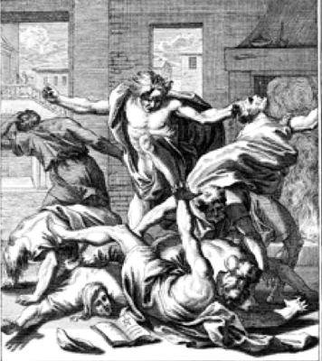
Acts 19:13 Then some of the itinerant Jewish exorcists took it upon themselves to call the name of the Lord Jesus over those who had evil spirits, saying, "We exorcise you by the Jesus whom Paul preaches." ¹⁴ Also there were seven sons of Sceva, a Jewish chief priest, who did so. ¹⁵ And the evil spirit
answered and said, "Jesus I know, and Paul I know; but who are you?" ¹⁶ Then the man in whom the evil spirit was leaped on them, overpowered them, and prevailed against them, so that they fled out of that house naked and wounded.

Slide 24
Hebrews 11:6 But without faith it is impossible to please Him, for he who comes to God must believe that He is, and that He is a rewarder of those who diligently seek Him.

Slide 25
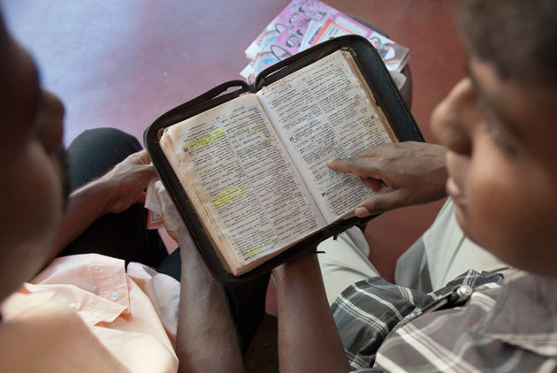
Romans 10:17 So then faith comes by hearing, and hearing by the word of God.

Slide 26
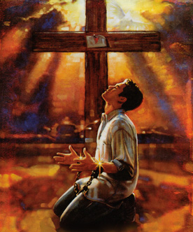
Luke 13:3 "I tell you, no; but unless you repent you will all likewise perish.

Slide 27
Romans 10:9 that if you confess with your mouth the Lord Jesus and believe in your heart that God has raised Him from the dead, you will be saved. ¹⁰ For with the heart one believes unto righteousness, and with the mouth confession is made unto salvation.

Slide 28
Matthew 10:32 " Therefore whoever confesses Me before men, him I will also confess before My Father who is in heaven. ³³ "But whoever denies Me before men, him I will also deny before My Father who is in heaven.

Slide 29

Hear
Believe
Repent
And
Confess

Slide 30
Ephesians 2:4 But God, who is rich in mercy, because of His great love with which He loved us, ⁵ even when we were dead in trespasses, made us alive together with Christ (by grace you have been saved),
When were we made alive together with Christ?

Slide 31
Colossians 2:11 In Him you were also circumcised with the circumcision made without hands, by putting off the body of the sins of the flesh, by the circumcision of Christ, ¹² buried with Him in baptism, in which you also were raised with Him through faith in the working of God, who raised Him from the dead. ¹³ And you, being dead in your trespasses and the uncircumcision of your flesh, He has made alive together with Him, having forgiven you all trespasses, See also Romans 6.

Slide 32

Hear
Believe
Repent
And
Confess
Be Baptized

Slide 33
WAKE UP
AND
LIVE
FOR GOD
Part 2

Slide 34
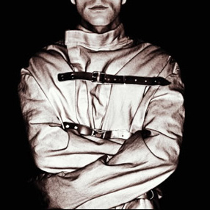
Christians who are limiting themselves and are not living the abundant life they could be.

Slide 35
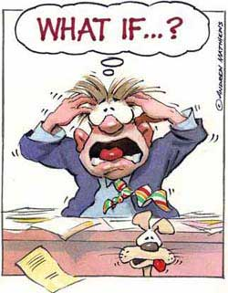
Worry

Slide 36
Matthew 6:25 " Therefore I say to you, do not worry about your life, what you will eat or what you will drink; nor about your body, what you will put on. Is not life more than food and the body more than clothing? ²⁶ "Look at the birds of the air, for they neither sow nor reap nor gather into barns; yet your heavenly Father feeds them. Are you not of more value than they? ²⁷ "Which of you by worrying can add one cubit to his stature? ²⁸ "So why do you worry about clothing? Consider the lilies of the field, how they grow: they neither toil nor spin;

Slide 37
²⁹ "and yet I say to you that even Solomon in all his glory was not arrayed like one of these. ³⁰ "Now if God so clothes the grass of the field, which today is, and tomorrow is thrown into the oven, will He not much more clothe you, O you of little faith? ³¹ "Therefore do not worry, saying, 'What shall we eat?' or 'What shall we drink?' or 'What shall we wear?' ³² "For after all these things the Gentiles seek. For your heavenly Father knows that you need all these things. ³³ "But seek first the kingdom of God and His righteousness, and all these things shall be added to you. ³⁴ "Therefore do not worry about tomorrow, for tomorrow will worry about its own things. Sufficient for the day is its own trouble.

Slide 38
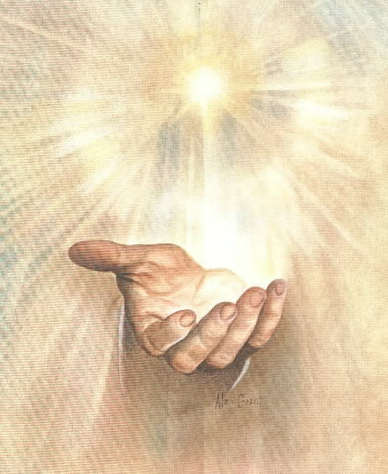
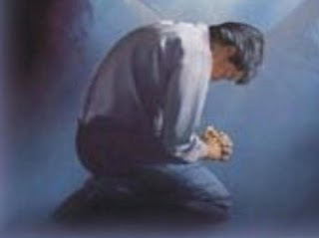
1 Peter 5:6 Therefore humble yourselves under the mighty hand of God, that He may exalt you in due time, ⁷ casting all your care upon Him, for He cares for you.

Slide 39
1 Timothy 6:6 Now godliness with contentment is great gain. ⁷ For we brought nothing into this world, and it is certain we can carry nothing out. ⁸ And having food and clothing, with these we shall be content.

Slide 40
Philippians 4:10 But I rejoiced in the Lord greatly that now at last your care for me has flourished again; though you surely did care, but you lacked opportunity. ¹¹ Not that I speak in regard to need, for I have learned in whatever state I am, to be content: ¹² I know how to be abased, and I know how to abound. Everywhere and in all things I have learned both to be full and to be hungry, both to abound and to suffer need. ¹³ I can do all things through Christ who strengthens me.

Slide 41
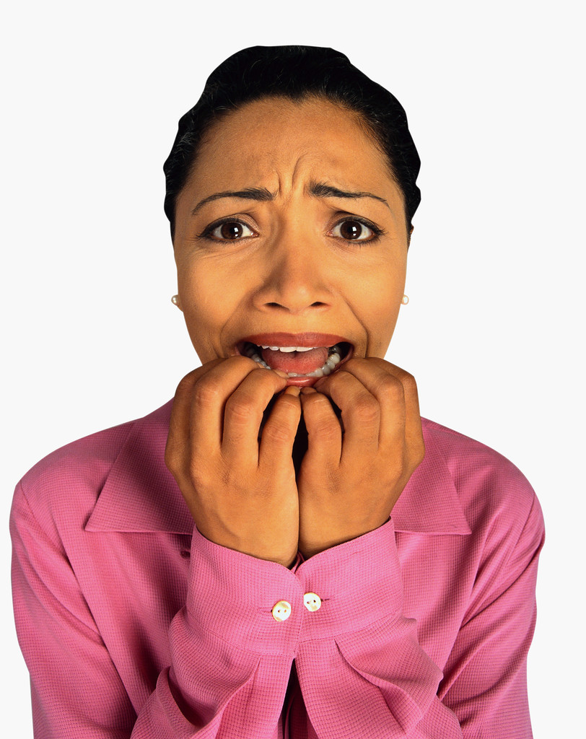
Fear

Slide 42
Deuteronomy 20:8 "The officers shall speak further to the people, and say, 'What man is there who is fearful and fainthearted? Let him go and return to his house, lest the heart of his brethren faint like his heart.'

Slide 43
Judges 7:3 "Now therefore, proclaim in the hearing of the people, saying, 'Whoever is fearful and afraid, let him turn and depart at once from Mount Gilead.' " And twenty-two thousand of the people returned, and ten thousand remained.

Slide 44
John 12:4 Nevertheless even among the rulers many believed in Him, but because of the Pharisees they did not confess Him, lest they should be put out of the synagogue; ⁴³ for they loved the praise of men more than the praise of God.

Slide 45
Proverbs 3:25 Do not be afraid of sudden terror, Nor of trouble from the wicked when it comes; ²⁶ For the LORD will be your confidence, And will keep your foot from being caught.
Matthew 10:28 "And do not fear those who kill the body but cannot kill the soul. But rather fear Him who is able to destroy both soul and body in hell.

Slide 46
Hebrews 13:5 Let your conduct be without covetousness; be content with such things as you have. For He Himself has said, "I will never leave you nor forsake you." ⁶ So we may boldly say: "The LORD is my helper; I will not fear. What can man do to me?“
Psalm 23:4 Yea, though I walk through the valley of the shadow of death, I will fear no evil; For You are with me; Your rod and Your staff, they comfort me.

Slide 47
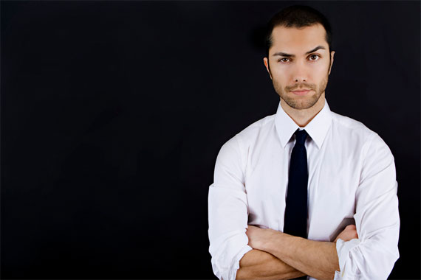
Murmuring and Complaining

Slide 48
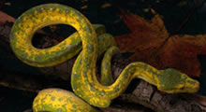
Numbers 21:4 Then they journeyed from Mount Hor by the Way of the Red Sea, to go around the land of Edom; and the soul of the people became very discouraged on the way. ⁵ And the people spoke against God and against Moses: "Why have you brought us up out of Egypt to die in the wilderness? For there is no food and no water, and our soul loathes this worthless bread." ⁶ So the LORD sent fiery serpents among the people, and they bit the people; and many of the people of Israel died.

Slide 49
Philippians 4:4 Rejoice in the Lord always. Again I will say, rejoice!
Philippians 2:14 Do all things without complaining and disputing, ¹⁵ that you may become blameless and harmless, children of God without fault in the midst of a crooked and perverse generation, among whom you shine as lights in the world, ¹⁶ holding fast the word of life, so that I may rejoice in the day of Christ that I have not run in vain or labored in vain.

Slide 50
Psalm 145:1 I will extol You, my God, O King; And I will bless Your name forever and ever. ² Every day I will bless You, And I will praise Your name forever and ever. ³ Great is the LORD, and greatly to be praised; And His greatness is unsearchable. ⁴ One generation shall praise Your works to another, And shall declare Your mighty acts. ⁵ I will meditate on the glorious splendor of Your majesty, And on Your wondrous works. ⁶ Men shall speak of the might of Your awesome acts, And I will declare Your greatness. ⁷ They shall utter the memory of Your great goodness, And shall sing of Your righteousness.

Slide 51
⁸ The LORD is gracious and full of compassion, Slow to anger and great in mercy. ⁹ The LORD is good to all, And His tender mercies are over all His works. ¹⁰ All Your works shall praise You, O LORD, And Your saints shall bless You. ¹¹ They shall speak of the glory of Your kingdom, And talk of Your power, ¹² To make known to the sons of men His mighty acts, And the glorious majesty of His kingdom. ¹³ Your kingdom is an everlasting kingdom, And Your dominion endures throughout all generations. ¹⁴ The LORD upholds all who fall, And raises up all who are bowed down. ¹⁵ The eyes of all look expectantly to You, And You give them their food in due season.

Slide 52
¹⁶ You open Your hand And satisfy the desire of every living thing. ¹⁷ The LORD is righteous in all His ways, Gracious in all His works. ¹⁸ The LORD is near to all who call upon Him, To all who call upon Him in truth. ¹⁹ He will fulfill the desire of those who fear Him; He also will hear their cry and save them. ²⁰ The LORD preserves all who love Him, But all the wicked He will destroy. ²¹ My mouth shall speak the praise of the LORD, And all flesh shall bless His holy name Forever and ever.

Slide 53

Doubting Ourselves

Slide 54
Jeremiah 1:4 Then the word of the LORD came to me, saying: ⁵ "Before I formed you in the womb I knew you; Before you were born I sanctified you; I ordained you a prophet to the nations." ⁶ Then said I: "Ah, Lord GOD! Behold, I cannot speak, for I am a youth." ⁷ But the LORD said to me: "Do not say, 'I am a youth,' For you shall go to all to whom I send you, And whatever I command you, you shall speak. ⁸ Do not be afraid of their faces, For I am with you to deliver you," says the LORD. ⁹ Then the LORD put forth His hand and touched my mouth, and the LORD said to me: "Behold, I have put My words in your mouth. ¹⁰ See, I have this day set you over the nations and over the kingdoms, To root out and to pull down, To destroy and to throw down, To build and to plant."

Slide 55
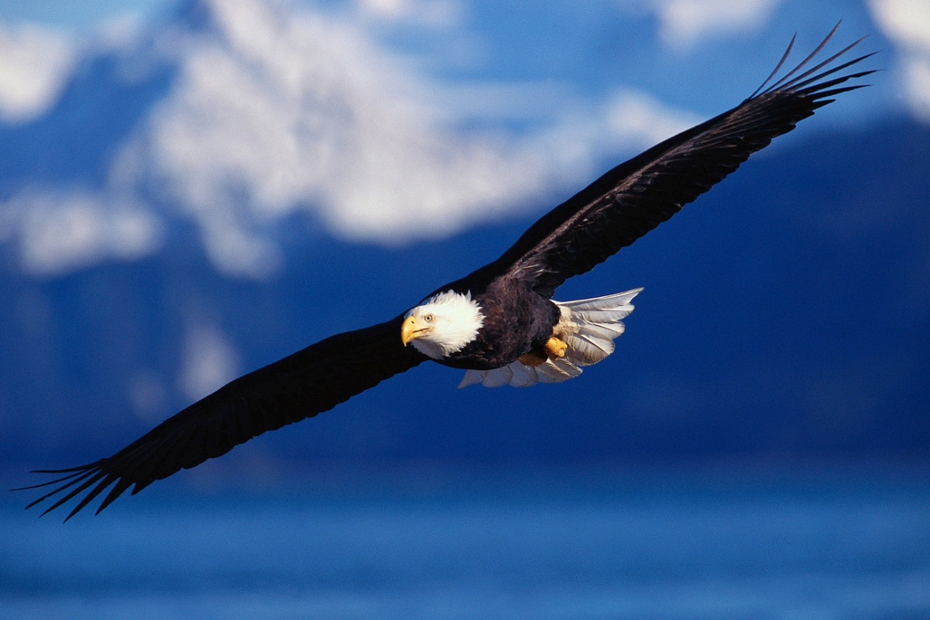
Isaiah 40:29 He gives power to the weak, And to those who have no might He increases strength. ³⁰ Even the youths shall faint and be weary, And the young men
shall utterly fall, ³¹ But those who wait on the LORD Shall renew their strength; They shall mount up with wings like eagles, They shall run and not be weary, They shall walk and not faint.

Slide 56
Hebrews 12:1 Therefore we also, since we are surrounded by so great a cloud of witnesses, let us lay aside every weight, and the sin which so easily ensnares us, and let us run with endurance the race that is set before us, ² looking unto Jesus, the author and finisher of our faith, who for the joy that was set before Him endured the cross, despising the shame, and has sat down at the right hand of the throne of God.

Slide 57
WAKE UP
AND
LIVE
FOR GOD

