Slide 1
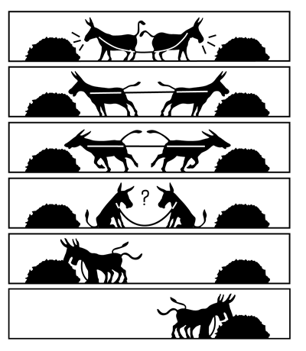
THE SPIRIT OF COMPROMISE

Slide 2
Bar-J-Suzy-Q-Flying-W-Lazy-Y

Slide 3
To compromise means to give up some principle/demand[s] so as to come to an agreement or to maintain peace.
Merritt Malloy said, “Compromise is simply changing the question to fit the answer.”

Slide 4
Matthew 7:13 " Enter by the narrow gate; for wide is the gate and broad is the way that leads to destruction, and there are many who go in by it. ¹⁴ "Because narrow is the gate and difficult is the way which leads to life, and there are few who find it.

Slide 5
Matthew 10:34 " Do not think that I came to bring peace on earth. I did not come to bring peace but a sword. ³⁵ "For I have come to 'set a man against his father, a daughter against her mother, and a daughter-in-law against her mother-in-law'; ³⁶ "and 'a man's enemies will be those of his own household.' ³⁷ "He who loves father or mother more than Me is not worthy of Me. And he who loves son or daughter more than Me is not worthy of Me. ³⁸ "And he who does not take his cross and follow after Me is not worthy of Me.

Slide 6
John 15:18 " If the world hates you, you know that it hated Me before it hated you. ¹⁹ "If you were of the world, the world would love its own. Yet because you are not of the world, but I chose you out of the world, therefore the world hates you. ²⁰ "Remember the word that I said to you, 'A servant is not greater than his master.' If they persecuted Me, they will also persecute you. If they kept My word, they will keep yours also.

Slide 7
John 16:2 "They will put you out of the synagogues; yes, the time is coming that whoever kills you will think that he offers God service.

Slide 8
Acts 14:22 strengthening the souls of the disciples, exhorting them to continue in the faith, and saying, "We must through many tribulations enter the kingdom of God."

Slide 9
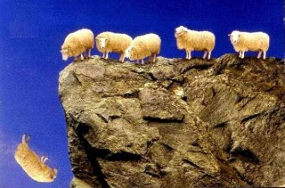
One reason Christians will compromise is because they want to fit in with the majority.

Slide 10
Galatians 1:9 As we have said before, so now I say again, if anyone preaches any other gospel to you than what you have received, let him be accursed. ¹⁰ For do I now persuade men, or God? Or do I seek to please men? For if I still pleased men, I would not be a bondservant of Christ.

Slide 11
Romans 12:1 I beseech you therefore, brethren, by the mercies of God, that you present your bodies a living sacrifice, holy, acceptable to God, which is your reasonable service. ² And do not be conformed to this world, but be transformed by the renewing of your mind, that you may prove what is that good and acceptable and perfect will of God. ³ For I say, through the grace given to me, to everyone who is among you, not to think of himself more highly than he ought to think, but to think soberly, as God has dealt to each one a measure of faith.

Slide 12
Proverbs 3:5 Trust in the LORD with all your heart, And lean not on your own understanding; ⁶ In all your ways acknowledge Him, And He shall direct your paths. ⁷ Do not be wise in your own eyes; Fear the LORD and depart from evil. ⁸ It will be health to your flesh, And strength to your bones.
Jeremiah 10:23 O LORD, I know the way of man is not in himself; It is not in man who walks to direct his own steps.

Slide 13
Another reason that can cause some to compromise God’s Word is family.

Slide 14
Luke 14:26 "If anyone comes to Me and does not hate his father and mother, wife and children, brothers and sisters, yes, and his own life also, he cannot be My disciple.
The parallel passage that goes with this one is:
Matthew 10:37 "He who loves father or mother more than Me is not worthy of Me. And he who loves son or daughter more than Me is not worthy of Me.

Slide 15
Money is another common temptation that will cause people to compromise the truth.

Slide 16
Matthew 16:26 "For what profit is it to a man if he gains the whole world, and loses his own soul? Or what will a man give in exchange for his soul?
^{ESV} Matthew 6:24 "No one can serve two masters, for either he will hate the one and love the other, or he will be devoted to the one and despise the other. You cannot serve God and money.

Slide 17
1 Timothy 6:6 Now godliness with contentment is great gain. ⁷ For we brought nothing into this world, and it is certain we can carry nothing out. ⁸ And having food and clothing, with these we shall be content. ⁹ But those who desire to be rich fall into temptation and a snare, and into many foolish and harmful lusts which drown men in destruction and perdition. ¹⁰ For the love of money is a root of all kinds of evil, for which some have strayed from the faith in their greediness, and pierced themselves through with many sorrows.

Slide 18
Thinking about the future can also cause people to compromise God’s Word especially when it comes to being overly concerned about the future of the church.

Slide 19
Revelation 3:16 "So then, because you are lukewarm, and neither cold nor hot, I will vomit you out of My mouth. ¹⁷ "Because you say, 'I am rich, have become wealthy, and have need of nothing' -- and do not know that you are wretched, miserable, poor, blind, and naked -- ¹⁸ "I counsel you to buy from Me gold refined in the fire, that you may be rich; and white garments, that you may be clothed, that the shame of your nakedness may not be revealed; and anoint your eyes with eye salve, that you may see. ¹⁹ "As many as I love, I rebuke and chasten. Therefore be zealous and repent.

Slide 20
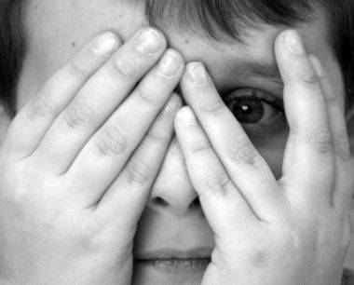
Some find themselves intimidated by fear.

Slide 21
Matthew 10:28 "And do not fear those who kill the body but cannot kill the soul. But rather fear Him who is able to destroy both soul and body in hell.
Revelation 21:8 "But the cowardly, unbelieving, abominable, murderers, sexually immoral, sorcerers, idolaters, and all liars shall have their part in the lake which burns with fire and brimstone, which is the second death."

Slide 22
2 Timothy 1:13 Hold fast the pattern of sound words which you have heard from me, in faith and love which are in Christ Jesus.

Slide 23
The last thing I want to point out that can cause some to compromise God’s truth is feelings or emotions in general.

Slide 24
Proverbs 23:7 For as he thinks in his heart, so is he.
Proverbs 28:26 He who trusts in his own heart is a fool, But whoever walks wisely will be delivered.

Slide 25
Matthew 4:1 Then Jesus was led up by the Spirit into the wilderness to be tempted by the devil. ² And when He had fasted forty days and forty nights, afterward He was hungry. ³ Now when the tempter came to Him, he said, "If You are the Son of God, command that these stones become bread." ⁴ But He answered and said, "It is written, 'Man shall not live by bread alone, but by every word that proceeds from the mouth of God.' "

Slide 26
Matthew 4:5 Then the devil took Him up into the holy city, set Him on the pinnacle of the temple, ⁶ and said to Him, "If You are the Son of God, throw Yourself down. For it is written: 'He shall give His angels charge over you,' and, 'In their hands they shall bear you up, Lest you dash your foot against a stone.' " ⁷ Jesus said to him, "It is written again, 'You shall not tempt the LORD your God.' "

Slide 27
Matthew 4:8 Again, the devil took Him up on an exceedingly high mountain, and showed Him all the kingdoms of the world and their glory. ⁹ And he said to Him, "All these things I will give You if You will fall down and worship me." ¹⁰ Then Jesus said to him, "Away with you, Satan! For it is written, 'You shall worship the LORD your God, and Him only you shall serve.' " ¹¹ Then the devil left Him, and behold, angels came and ministered to Him.

Slide 28
2 Timothy 4:7 I have fought the good fight, I have finished the race, I have kept the faith.

