Slide 1
THE STRANGE
AND THE
SPOOKY
PART 2
MAGICIANS AND MEDIUMS

Slide 2
Genesis 41:8 Now it came to pass in the morning that his spirit was troubled, and he sent and called for all the magicians of Egypt and all its wise men. And Pharaoh told them his dreams, but there was no one who could interpret them for Pharaoh.

Slide 3
Genesis 41:15 And Pharaoh said to Joseph, "I have had a dream, and there is no one who can interpret it. But I have heard it said of you that you can understand a dream, to interpret it." 16 So Joseph answered Pharaoh, saying, "It is not in me; God will give Pharaoh an answer of peace."

Slide 4
Exodus 7:10 So Moses and Aaron went in to Pharaoh, and they did so, just as the LORD commanded. And Aaron cast down his rod before Pharaoh and before his servants, and it became a serpent. 11 But Pharaoh also called the wise men and the sorcerers; so the magicians of Egypt, they also did in like manner with their enchantments. 12 For every man threw down his rod, and they became serpents. But Aaron's rod swallowed up their rods.

Slide 5
Exodus 8:18 Now the magicians so worked with their enchantments to bring forth lice, but they could not. So there were lice on man and beast. 19 Then the magicians said to Pharaoh, "This is the finger of God."

Slide 6
Acts 8:9 But there was a certain man called Simon, who previously practiced sorcery in the city and astonished the people of Samaria, claiming that he was someone great, 10 to whom they all gave heed, from the least to the greatest, saying, "This man is the great power of God." 11 And they heeded him because he had astonished them with his sorceries for a long time. 12 But when they believed Philip as he preached the things concerning the kingdom of God and the name of Jesus Christ, both men and women were baptized. 13 Then Simon himself also believed; and when he was baptized he continued with Philip, and was amazed, seeing the miracles and signs which were done.

Slide 7
Mark 16:20 And they went out and preached everywhere, the Lord working with them and confirming the word through the accompanying signs.

Slide 8
Acts 19:11 Now God worked unusual miracles by the hands of Paul, 12 so that even handkerchiefs or aprons were brought from his body to the sick, and the diseases left them and the evil spirits went out of them. 13 Then some of the itinerant Jewish exorcists took it upon themselves to call the name of the Lord Jesus over those who had evil spirits, saying, "We exorcise you by the Jesus whom Paul preaches." 14 Also there were seven sons of Sceva, a Jewish chief priest, who did so. 15 And the evil spirit answered and said, "Jesus I know, and Paul I know; but who are you?"

Slide 9
16 Then the man in whom the evil spirit was leaped on them, overpowered them, and prevailed against them, so that they fled out of that house naked and wounded. 17 This became known both to all Jews and Greeks dwelling in Ephesus; and fear fell on them all, and the name of the Lord Jesus was magnified. 18 And many who had believed came confessing and telling their deeds. 19 Also, many of those who had practiced magic brought their books together and burned them in the sight of all. And they counted up the value of them, and it totaled fifty thousand pieces of silver. 20 So the word of the Lord grew mightily and prevailed.

Slide 10
Zechariah 10:2 For the idols speak delusion; The diviners envision lies, And tell false dreams; They comfort in vain.
Jeremiah 14:14 And the LORD said to me, "The prophets prophesy lies in My name. I have not sent them, commanded them, nor spoken to them; they prophesy to you a false vision, divination, a worthless thing, and the deceit of their heart.

Slide 11
Ezekiel 13:6 "They have envisioned futility and false divination, saying, 'Thus says the LORD!' But the LORD has not sent them; yet they hope that the word may be confirmed. 7 "Have you not seen a futile vision, and have you not spoken false divination? You say, 'The LORD says,' but I have not spoken." 8 Therefore thus says the Lord GOD: "Because you have spoken nonsense and envisioned lies, therefore I am indeed against you," says the Lord GOD.

Slide 12
2 Thessalonians 2:9 The coming of the lawless one is according to the working of Satan, with all power, signs, and lying wonders, 10 and with all unrighteous deception among those who perish

Slide 13
Judges 6:36 So Gideon said to God, "If You will save Israel by my hand as You have said -- 37 "look, I shall put a fleece of wool on the threshing floor; if there is dew on the fleece only, and it is dry on all the ground, then I shall know that You will save Israel by my hand, as You have said." 38 And it was so. When he rose early the next morning and squeezed the fleece together, he wrung the dew out of the fleece, a bowlful of water. 39 Then Gideon said to God, "Do not be angry with me, but let me speak just once more: Let me test, I pray, just once more with the fleece; let it now be dry only on the fleece, but on all the ground let there be dew." 40 And God did so that night. It was dry on the fleece only, but there was dew on all the ground.

Slide 14
Proverbs 16:33 The lot is cast into the lap, But its every decision is from the LORD.

Slide 15
Acts 1:24 And they prayed and said, "You, O Lord, who know the hearts of all, show which of these two You have chosen 25 "to take part in this ministry and apostleship from which Judas by transgression fell, that he might go to his own place." 26 And they cast their lots, and the lot fell on Matthias. And he was numbered with the eleven apostles.

Slide 16
Hosea 4:12 My people ask counsel from their wooden idols, And their staff informs them.
Ezekiel 21:21 "For the king of Babylon stands at the parting of the road, at the fork of the two roads, to use divination: he shakes the arrows, he consults the images, he looks at the liver.

Slide 17
Deuteronomy 18:10 "There shall not be found among you anyone who makes his son or his daughter pass through the fire, or one who practices witchcraft, or a soothsayer, or one who interprets omens, or a sorcerer, 11 "or one who conjures spells, or a medium, or a spiritist, or one who calls up the dead. 12 "For all who do these things are an abomination to the LORD, and because of these abominations the LORD your God drives them out from before you.

Slide 18
Leviticus 20:27 ' A man or a woman who is a medium, or who has familiar spirits, shall surely be put to death; they shall stone them with stones. Their blood shall be upon them.' "

Slide 19
Matthew 10:28 "And do not fear those who kill the body but cannot kill the soul. But rather fear Him who is able to destroy both soul and body in hell.

Slide 20
Ecclesiastes 8:8 No man has power to retain the spirit, or power over the day of death.

Slide 21
Revelation 1:18 "I am He who lives, and was dead, and behold, I am alive forevermore. Amen. And I have the keys of Hades and of Death.

Slide 22
Ecclesiastes 9:5 For the living know that they will die; But the dead know nothing, And they have no more reward, For the memory of them is forgotten. 6 Also their love, their hatred, and their envy have now perished; Nevermore will they have a share In anything done under the sun.

Slide 23
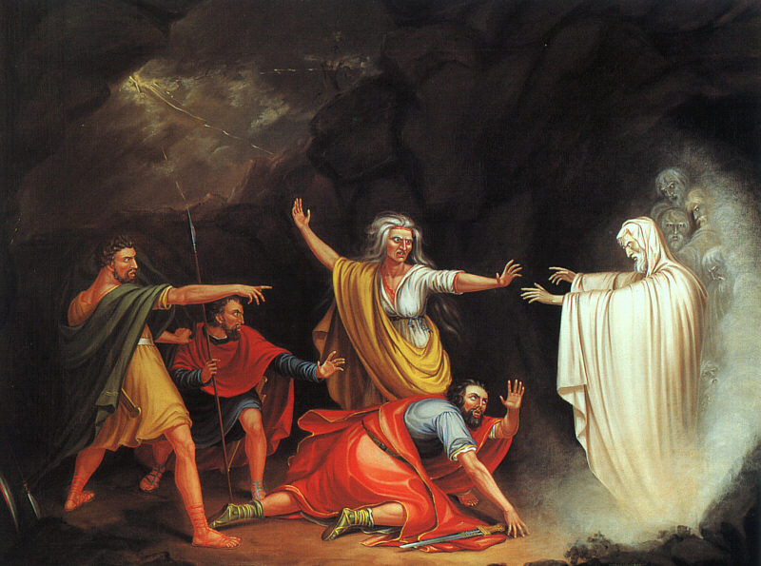
1 Samuel 28:3 Now Samuel had died, and all Israel had lamented for him and buried him in Ramah, in his own city. And Saul had put the mediums and the spiritists out of the land. 4 Then the Philistines gathered together, and came and
encamped at Shunem. So Saul gathered all Israel together, and they encamped at Gilboa. 5 When Saul saw the army of the Philistines, he was afraid, and his heart trembled greatly. 6 And when Saul inquired of the LORD, the LORD did not answer him, either by dreams or by Urim or by the prophets.

Slide 24
7 Then Saul said to his servants, "Find me a woman who is a medium, that I may go to her and inquire of her." And his servants said to him, "In fact, there is a woman who is a medium at En Dor." 8 So Saul disguised himself
and put on other clothes, and he went, and two men with him; and they came to the woman by night. And he said, "Please conduct a seance for me, and bring up for me the one I shall name to you." 9 Then the woman said to him, "Look, you know what Saul has done, how he has cut off the mediums and the spiritists from the land. Why then do you lay a snare for my life, to cause me to die?"

Slide 25
10 And Saul swore to her by the LORD, saying, "As the LORD lives, no punishment shall come upon you for this thing." 11 Then the woman said, "Whom shall I bring up for you?" And he said, "Bring up Samuel for me." 12
When the woman saw Samuel, she cried out with a loud voice. And the woman spoke to Saul, saying, "Why have you deceived me? For you are Saul!" 13 And the king said to her, "Do not be afraid. What did you see?" And the woman said to Saul, "I saw a spirit ascending out of the earth."

Slide 26
14 So he said to her, "What is his form?" And she said, "An old man is coming up, and he is covered with a mantle." And Saul perceived that it was Samuel, and he stooped with his face to the ground and bowed down. 15 Now
Samuel said to Saul, "Why have you disturbed me by bringing me up?" And Saul answered, "I am deeply distressed; for the Philistines make war against me, and God has departed from me and does not answer me anymore, neither by prophets nor by dreams. Therefore I have called you, that you may reveal to me what I should do."

Slide 27
16 Then Samuel said: "Why then do you ask me, seeing the LORD has departed from you and has become your enemy? 17 "And the LORD has done for Himself as He spoke by me. For the LORD has torn the kingdom out of your hand and given
it to your neighbor, David. 18 "Because you did not obey the voice of the LORD nor execute His fierce wrath upon Amalek, therefore the LORD has done this thing to you this day. 19 "Moreover the LORD will also deliver Israel with you into the hand of the Philistines. And tomorrow you and your sons will be with me. The LORD will also deliver the army of Israel into the hand of the Philistines."

Slide 28
20 Then immediately Saul fell full length on the ground, and was dreadfully afraid because of the words of Samuel. And there was no strength in him, for he had eaten no food all day or all night. 21 And the woman came to Saul and
saw that he was severely troubled, and said to him, "Look, your maidservant has obeyed your voice, and I have put my life in my hands and heeded the words which you spoke to me. 22 "Now therefore, please, heed also the voice of your maidservant, and let me set a piece of bread before you; and eat, that you may have strength when you go on your way."

Slide 29
23 But he refused and said, "I will not eat." So his servants, together with the woman, urged him; and he heeded their voice. Then he arose from the ground and sat on the bed. 24 Now the woman had a fatted calf in the house, and she
hastened to kill it. And she took flour and kneaded it, and baked unleavened bread from it. 25 So she brought it before Saul and his servants, and they ate. Then they rose and went away that night.

Slide 30
12 When the woman saw Samuel, she cried out with a loud voice. And the woman spoke to Saul, saying, "Why have you deceived me? For you are Saul!"

Slide 31
Three possible explanations
1. The witch made everything up
2. The devil manifested himself as Samuel
3. God allowed Samuel to speak to Saul to pronounce judgment on him one last time

