Slide 1
THE STRANGE
AND THE
SPOOKY
PART 1

Slide 2
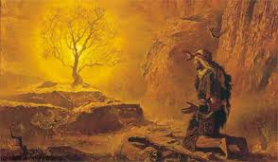
Exodus 3:1 Now Moses was tending the flock of Jethro his father-in-law, the priest of Midian. And he led the flock to the back of the desert, and came to Horeb, the mountain of God. ² And
the Angel of the LORD appeared to him in a flame of fire from the midst of a bush. So he looked, and behold, the bush was burning with fire, but the bush was not consumed. ³ Then Moses said, "I will now turn aside and see this great sight, why the bush does not burn."

Slide 3
⁴ So when the LORD saw that he turned aside to look, God called to him from the midst of the bush and said, "Moses, Moses!" And he said, "Here I am." ⁵ Then He said, "Do not draw near this place. Take
your sandals off your feet, for the place where you stand is holy ground." ⁶ Moreover He said, "I am the God of your father -- the God of Abraham, the God of Isaac, and the God of Jacob." And Moses hid his face, for he was afraid to look upon God.

Slide 4
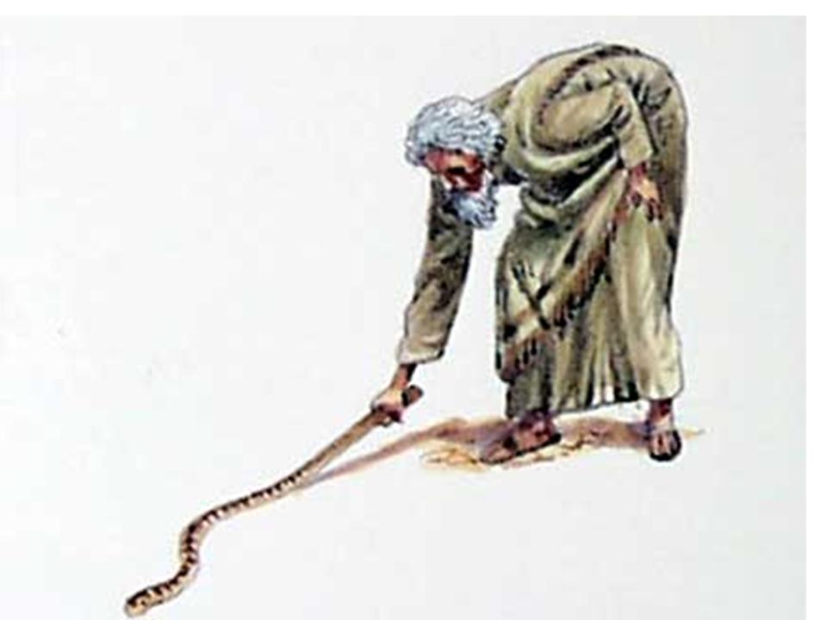
Exodus 4:1 Then Moses answered and said, "But suppose they will not believe me or listen to my voice; suppose they say, 'The LORD has not appeared to you.' " ² So the LORD said to him, "What is that in your hand?" He said, "A rod." ³ And He said, "Cast it on the ground."
So he cast it on the ground, and it became a serpent; and Moses fled from it. ⁴ Then the LORD said to Moses, "Reach out your hand and take it by the tail" (and he reached out his hand and caught it, and it became a rod in his hand), ⁵ "that they may believe that the LORD God of their fathers, the God of Abraham, the God of Isaac, and the God of Jacob, has appeared to you

Slide 5
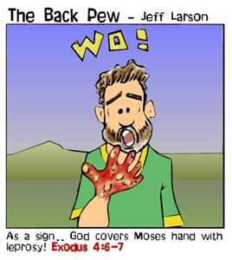
." ⁶ Furthermore the LORD said to him, "Now put your hand in your bosom." And he put his hand in his bosom, and when he took it out, behold, his hand was leprous, like snow. ⁷ And He said, "Put your hand in your bosom again." So he put his hand in his bosom again, and drew it
out of his bosom, and behold, it was restored like his other flesh. ⁸ "Then it will be, if they do not believe you, nor heed the message of the first sign, that they may believe the message of the latter sign.

Slide 6
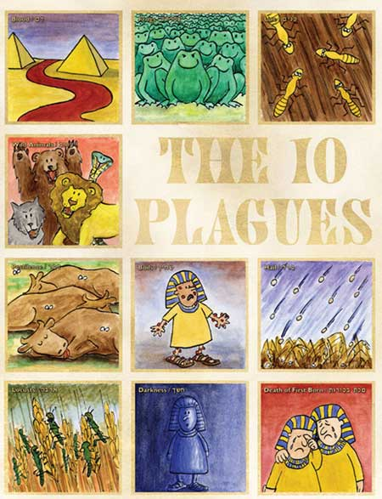
1. Water to Blood
2. Frogs
3. Gnats or Lice
4. Flies
5. Livestock Diseased
6. Boils
7. Thunder and Hail
8. Locusts
9. Darkness
10. Death of the Firstborn

Slide 7
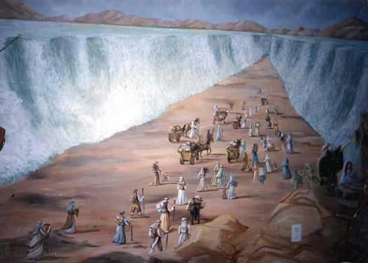

Slide 8
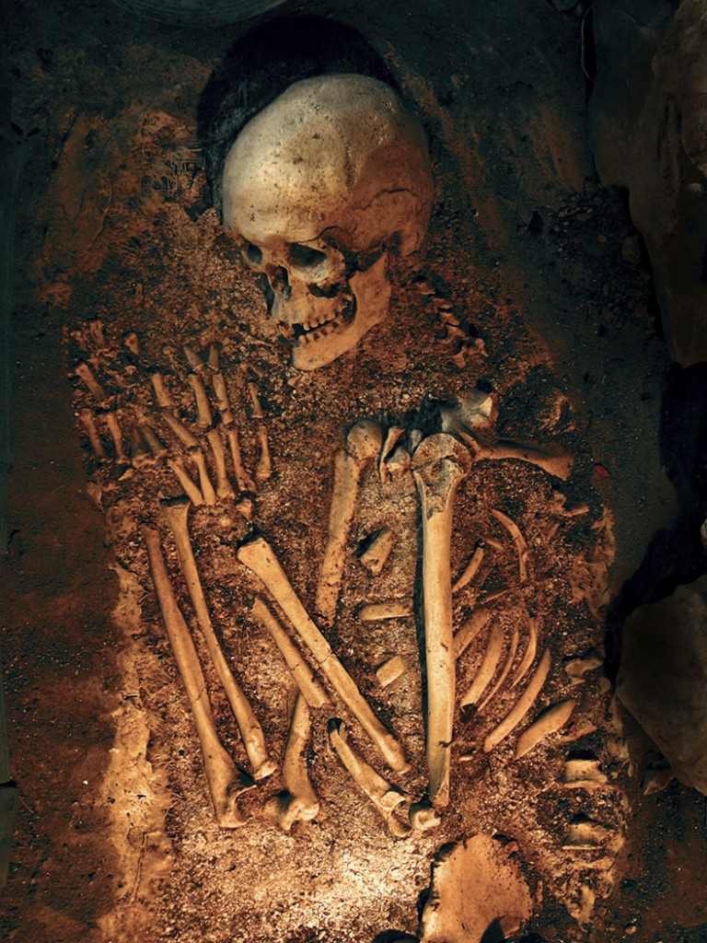
2 Kings 13:20 Then Elisha died, and they buried him. And the raiding bands from Moab invaded the land in the spring of the year. ²¹ So it was, as they were burying a man, that suddenly they spied a band of raiders; and they put the man in the tomb of Elisha; and when the man was let down and touched the bones of Elisha, he revived and stood on his feet.

Slide 9
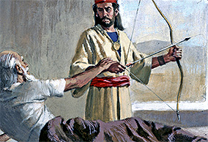
2 Kings 13:14 Elisha had become sick with the illness of which he would die. Then Joash the king of Israel came down to him, and wept over his face, and said, "O my
father, my father, the chariots of Israel and their horsemen!" ¹⁵ And Elisha said to him, "Take a bow and some arrows." So he took himself a bow and some arrows. ¹⁶ Then he said to the king of Israel, "Put your hand on the bow." So he put his hand on it, and Elisha put his hands on the king's hands. ¹⁷ And he said, "Open the east window"; and he opened it. Then Elisha said, "Shoot"; and he shot.

Slide 10
And he said, "The arrow of the LORD's deliverance and the arrow of deliverance from Syria; for you must strike the Syrians at Aphek till you have destroyed them." ¹⁸ Then he
said, "Take the arrows"; so he took them. And he said to the king of Israel, "Strike the ground"; so he struck three times, and stopped. ¹⁹ And the man of God was angry with him, and said, "You should have struck five or six times; then you would have struck Syria till you had destroyed it! But now you will strike Syria only three times."

Slide 11
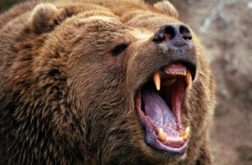
2 Kings 2:23 Then he went up from there to Bethel; and as he was going up the road, some youths came from the city and mocked him, and said to him, "Go
up, you baldhead! Go up, you baldhead!" ²⁴ So he turned around and looked at them, and pronounced a curse on them in the name of the LORD. And two female bears came out of the woods and mauled forty-two of the youths. ²⁵ Then he went from there to Mount Carmel, and from there he returned to Samaria.

Slide 12
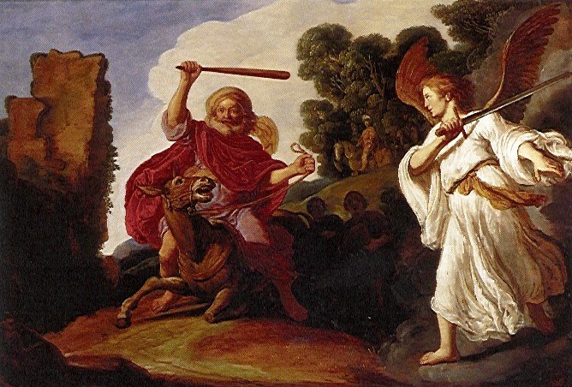
Numbers 22:21 So Balaam rose in the morning, saddled his donkey, and went with the princes of Moab. ²² Then God's anger was aroused because he went, and the Angel of
the LORD took His stand in the way as an adversary against him. And he was riding on his donkey, and his two servants were with him. ²³ Now the donkey saw the Angel of the LORD standing in the way with His drawn sword in His hand, and the donkey turned aside out of the way and went into the field.

Slide 13
So Balaam struck the donkey to turn her back onto the road. ²⁴ Then the Angel of the LORD stood in a narrow path between the vineyards, with a wall on this side and a wall on that side.
²⁵ And when the donkey saw the Angel of the LORD, she pushed herself against the wall and crushed Balaam's foot against the wall; so he struck her again. ²⁶ Then the Angel of the LORD went further, and stood in a narrow place where there was no way to turn either to the right hand or to the left. ²⁷ And when the donkey saw the Angel of the LORD, she lay down under Balaam; so Balaam's anger was aroused, and he struck the donkey with his staff.

Slide 14
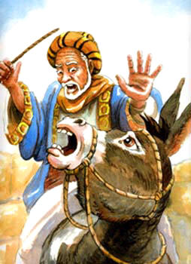
²⁸ Then the LORD opened the mouth of the donkey, and she said to Balaam, "What have I done to you, that you have struck me these three times?" ²⁹ And Balaam said to the donkey, "Because you have abused me. I wish there were a sword in my hand, for now I would kill you!" ³⁰ So the donkey said to Balaam, "Am I not
your donkey on which you have ridden, ever since I became yours, to this day? Was I ever disposed to do this to you?" And he said, "No."

Slide 15
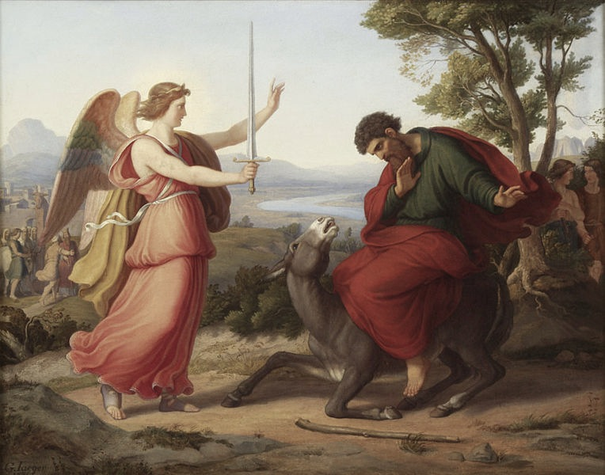
³¹ Then the LORD opened Balaam's eyes, and he saw the Angel of the LORD standing in the way with His drawn sword in His hand; and he bowed his head and fell flat on his face. ³² And the Angel of the LORD said to him, "Why have you struck your
donkey these three times? Behold, I have come out to stand against you, because your way is perverse before Me. ³³ "The donkey saw Me and turned aside from Me these three times. If she had not turned aside from Me, surely I would also have killed you by now, and let her live." ³⁴ And Balaam said to the Angel of the LORD, "I have sinned, for I did not know You stood in the way against me. Now therefore, if it displeases You, I will turn back."

Slide 16
Ezekiel 37:1 The hand of the LORD came upon me and brought me out in the Spirit of the LORD, and set me down in the midst of the valley; and it was full of bones. ² Then He caused me to pass by them all around, and behold, there were very many in the open valley; and indeed they were very dry. ³ And He said to me, "Son of man, can these bones live?" So I answered, "O Lord GOD, You know." ⁴ Again He said to me, "Prophesy to these bones, and say to them, 'O dry bones, hear the word of the LORD! ⁵ 'Thus says the Lord GOD to these bones: "Surely I will cause breath to enter into you, and you shall live.

Slide 17
⁶ "I will put sinews on you and bring flesh upon you, cover you with skin and put breath in you; and you shall live. Then you shall know that I am the LORD." ' " ⁷ So I prophesied as I was commanded; and as I prophesied, there was a noise, and suddenly a rattling; and the bones came together, bone to bone. ⁸ Indeed, as I looked, the sinews and the flesh came upon them, and the skin covered them over; but there was no breath in them. ⁹ Also He said to me, "Prophesy to the breath, prophesy, son of man, and say to the breath, 'Thus says the Lord GOD: "Come from the four winds, O breath, and breathe on these slain, that they may live." '

Slide 18
" ¹⁰ So I prophesied as He commanded me, and breath came into them, and they lived, and stood upon their feet, an exceedingly great army. ¹¹ Then He said to me, "Son of man, these bones are the whole house of Israel. They indeed say, 'Our bones are dry, our hope is lost, and we ourselves are cut off!' ¹² "Therefore prophesy and say to them, 'Thus says the Lord GOD: "Behold, O My people, I will open your graves and cause you to come up from your graves, and bring you into the land of Israel.

Slide 19
¹³ "Then you shall know that I am the LORD, when I have opened your graves, O My people, and brought you up from your graves. ¹⁴ "I will put My Spirit in you, and you shall live, and I will place you in your own land. Then you shall know that I, the LORD, have spoken it and performed it," says the LORD.' "

Slide 20
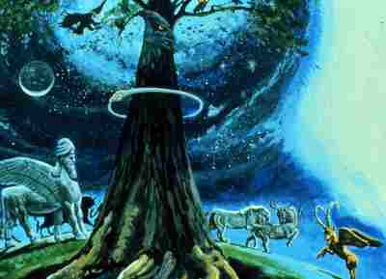
Daniel 4:10"These were the visions of my head while on my bed: "I was looking, and behold, A tree in the midst of the earth, And its height was great. ¹¹ The tree grew and became strong; Its height reached to the heavens, And it could be seen to the ends
of all the earth. ¹² Its leaves were lovely, Its fruit abundant, And in it was food for all. The beasts of the field found shade under it, The birds of the heavens dwelt in its branches, And all flesh was fed from it. ¹³ " I saw in the visions of my head while on my bed, and there was a watcher, a holy one, coming down from heaven. ¹⁴ He cried aloud and said thus: 'Chop down the tree and cut off

Slide 21
its branches, Strip off its leaves and scatter its fruit. Let the beasts get out from under it, And the birds from its branches. ¹⁵ Nevertheless leave the stump and roots in the earth, Bound with a band of iron and bronze, In the tender grass of the field.
Let it be wet with the dew of heaven, And let him graze with the beasts On the grass of the earth. ¹⁶ Let his heart be changed from that of a man, Let him be given the heart of a beast, And let seven times pass over him. ¹⁷ 'This decision is by the decree of the watchers, And the

Slide 22
sentence by the word of the holy ones, In order that the living may know That the Most High rules in the kingdom of men, Gives it to whomever He will, And sets over it the lowest of men.' ¹⁸ "This dream I, , have seen. Now you, Belteshazzar, declare its interpretation, since all the wise men of my kingdom are not able to make known to me the interpretation; but you are able, for the Spirit of the Holy God is in you."

Slide 23
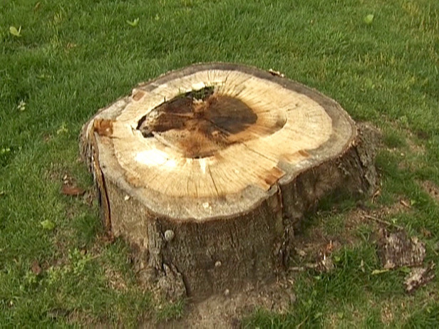
Daniel 4:25 They shall drive you from men, your dwelling shall be with the beasts of the field, and they shall make you eat grass like oxen. They shall wet you with the dew of heaven, and seven times shall pass over you,
till you know that the Most High rules in the kingdom of men, and gives it to whomever He chooses. ²⁶ And inasmuch as they gave the command to leave the stump and roots of the tree, your kingdom shall be assured to you, after you come to know that Heaven rules. ²⁷ Therefore, O king, let my advice be acceptable to you; break off your sins by being righteous, and your iniquities by showing mercy to the poor. Perhaps there may be a lengthening of your prosperity."

Slide 24
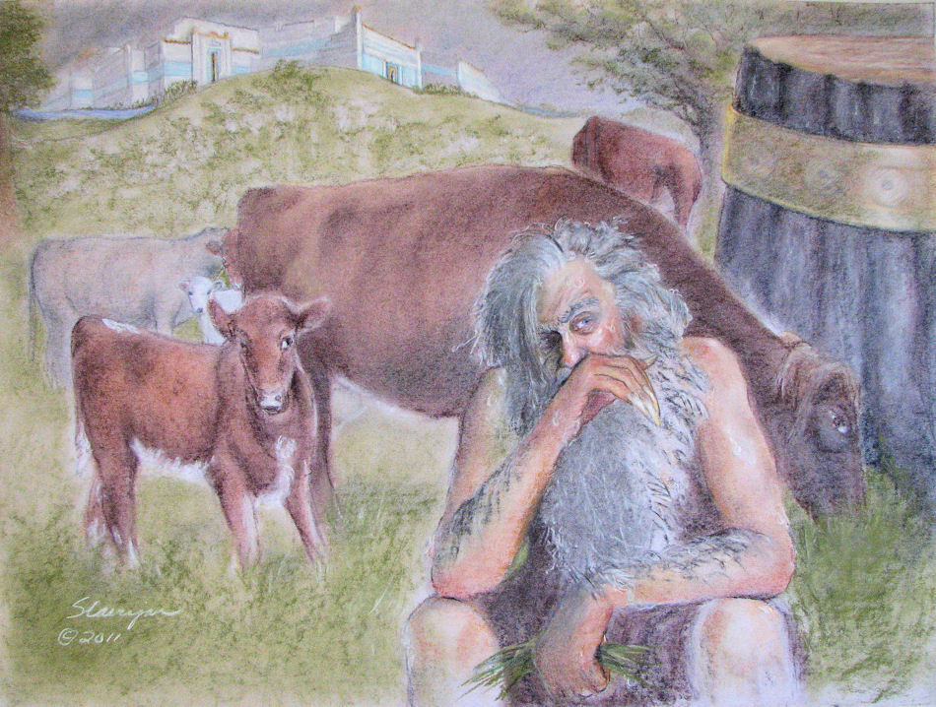
Daniel 4:28 All this came upon King Nebuchadnezzar. ²⁹ At the end of the twelve months he was walking about the royal palace of Babylon. ³⁰ The king spoke, saying, "Is not this great Babylon, that I have built for a royal dwelling by my mighty
power and for the honor of my majesty?" ³¹ While the word was still in the king's mouth, a voice fell from heaven: "King Nebuchadnezzar, to you it is spoken: the kingdom has departed from you! ³² And they shall drive you from men, and your dwelling shall be with the beasts

Slide 25
of the field. They shall make you eat grass like oxen; and seven times shall pass over you, until you know that the Most High rules in the kingdom of men, and gives it to whomever He chooses." ³³ That very hour the word was fulfilled concerning
Nebuchadnezzar; he was driven from men and ate grass like oxen; his body was wet with the dew of heaven till his hair had grown like eagles' feathers and his nails like birds' claws.

Slide 26
³⁴ And at the end of the time I, Nebuchadnezzar, lifted my eyes to heaven, and my understanding returned to me; and I blessed the Most High and praised and honored Him who lives forever: For His dominion is an everlasting dominion, And His kingdom is from generation to generation. ³⁵ All the inhabitants of the earth are reputed as nothing; He does according to His will in the army of heaven And among the inhabitants of the earth. No one can restrain His hand Or say to Him, "What have You done?" ³⁶ At the same time my reason returned to me, and for the glory of my kingdom, my honor and splendor returned to me. My counselors and nobles resorted to me, I was restored to my kingdom, and excellent majesty was added to me. ³⁷ Now I, Nebuchadnezzar, praise and extol and honor the King of heaven, all of whose works are truth, and His ways justice. And those who walk in pride He is able to put down.

Slide 27
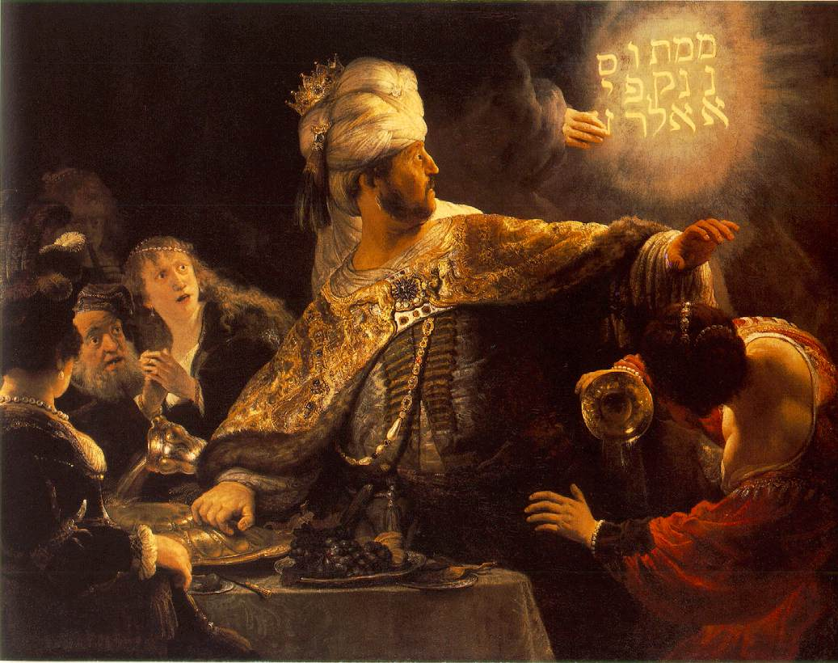
Daniel 5:1 Belshazzar the king made a great feast for a thousand of his lords, and drank wine in the presence of the thousand. ² While he tasted the wine, Belshazzar gave the command to bring the gold and silver vessels which his father Nebuchadnezzar had
taken from the temple which had been in Jerusalem, that the king and his lords, his wives, and his concubines might drink from them. ³ Then they brought the gold vessels that had been taken from the temple of the house of God which had been in Jerusalem; and the king and his lords, his wives, and his concubines drank from them.

Slide 28
⁴ They drank wine, and praised the gods of gold and silver, bronze and iron, wood and stone. ⁵ In the same hour the fingers of a man's hand appeared and wrote opposite the lampstand on the plaster of the wall of the king's palace; and the king saw
the part of the hand that wrote. ⁶ Then the king's countenance changed, and his thoughts troubled him, so that the joints of his hips were loosened and his knees knocked against each other.

Slide 29
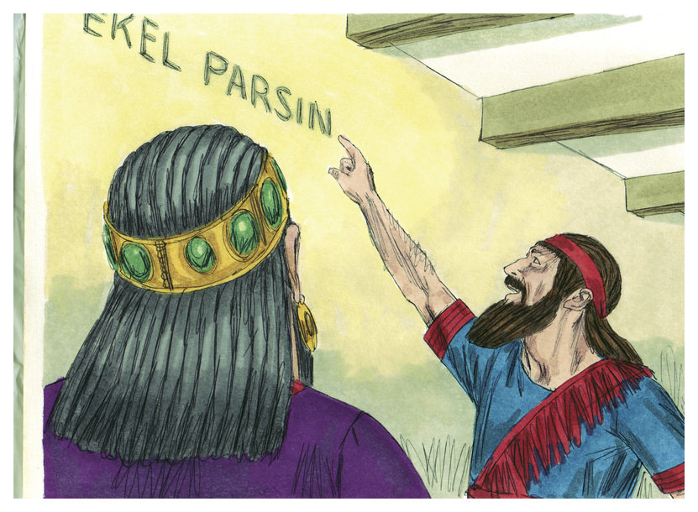
Daniel 5:22 "But you his son, Belshazzar, have not humbled your heart, although you knew all this. ²³ "And you have lifted yourself up against the Lord of heaven. They have brought the vessels of His house before you, and you
and your lords, your wives and your concubines, have drunk wine from them. And you have praised the gods of silver and gold, bronze and iron, wood and stone, which do not see or hear or know; and the God who holds your breath in His hand and owns all your ways, you have not glorified. ²⁴ "Then the fingers of the hand were sent from

Slide 30
Him, and this writing was written. ²⁵ " And this is the inscription that was written: MENE, MENE, TEKEL, UPHARSIN. ²⁶ "This is the interpretation of each word. MENE: God has numbered your kingdom, and finished it; ²⁷ "TEKEL:
You have been weighed in the balances, and found wanting; ²⁸ "PERES: Your kingdom has been divided, and given to the Medes and Persians."

