Slide 1
THE LIFE OF CHRIST
PART 4

Slide 2
John 1:1In the beginning was the Word, and the Word was with God, and the Word was God. ² He was in the beginning with God. ³ All things were made through Him, and without Him nothing was made that was made.
John 1:14 And the Word became flesh and dwelt among us, and we beheld His glory, the glory as of the only begotten of the Father, full of grace and truth.

Slide 3
The Godhead (Acts 17:29, Rom. 1:20, Col. 2:9).
The word “God” or “Godhead” simply means Deity.

Slide 4
Please note that all three are called God in Scripture:
Father – (Jn. 3:16; 6:27; 2 Pet. 1:17)
Jesus – (Heb. 1:8; Tit. 2:13; 2 Pet. 1:1)
Holy Spirit – (Acts 5:3-4)

Slide 5
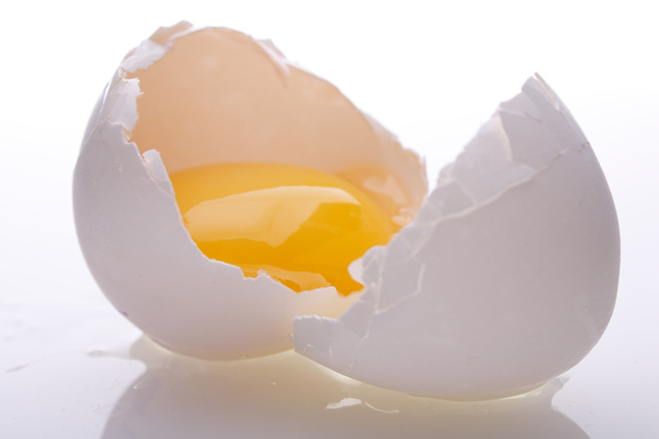
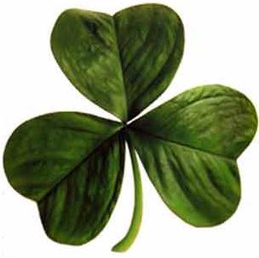

Slide 6
Genesis 1:1 In the beginning God created the heavens and the earth. ² The earth was without form, and void; and darkness was on the face of the deep. And the Spirit of God was hovering over the face of the waters.
God the Farther is the planner, and God the Son is the Creator as He carries out the Father’s plan. The Holy Spirit is the organizer as He is described as hovering over the water in verse 2.

Slide 7
Elohim is in plural form, which means there is more than one person that makes up God.
Gen. 1:26, 3:22, 11:7; Isa. 6:8

Slide 8
There are many New Testament passages that show all three members of the Godhead as well (Mt. 28:19; Eph. 4:4-6; Mt. 3:16-17; Lk. 3:21-22; Jn.1:32; Acts 10:38, 2 Cor. 13:14; 1 Jn. 5:7; 1 Pet. 1:2; Jude 20-21; 1 Cor. 12:4-6).
Matthew 28:19 "Go therefore and make disciples of all the nations, baptizing them in the name of the Father and of the Son and of the Holy Spirit,

Slide 9
We can also see some differences in the members of the Godhead in following passages:
Jesus is a mediator between humans and the Father (1 Tim. 2:5).
The Father knows, but Jesus does not (Mk. 13:32).
The Father will send the Holy Spirit and replace Jesus as a comforter (Jn. 14:26).

Slide 10
Jesus
I and my Father are one (Jn. 10:30). (Not one person, but one in unity and doctrine (2 Jn. 1:9) Similar to the husband and wife being one flesh (Mt. 19:5). (See Jn. 17:21 and 1 Cor. 12:12.)
He said that “I AM,” which means “to be, self-existence” (Jn. 8:58; Ex. 3:14).
You will die in your sins if you do not believe Jesus is God (Jn. 8:24).
Jesus said you are to worship God (Lk. 4:8). Revelation 22:8-9 states you are to worship God. (See also (Acts 14:14-15; 10, 25-26) Jesus accepts worship (Mt. 8:2).
Thomas said “my Lord, my God” without correction (Jn. 20:28). Jesus was not an angel, and God the Father calls Him God (Heb. 1:4-9).
Jesus was not created (Isa. 43:10).
Jesus created the world (Col. 1:16-17.)
Jesus forgave sin (Mk. 2:5-9, Isa. 44:22).

Slide 11
Holy Spirit
He speaks, hears, resists, wills, and guides.
The Holy Spirit is called God (Acts 5:3-4).
Hears and guides into all truths (Jn. 16:13).
He speaks (1 Tim 4:1; Acts 10:19-20).
He teaches (Jn. 14:26).
He forbids (Acts 16: 6-7).
He wills (1Cor. 12:11).
He can be grieved (Eph. 4:30).
It seemed good to the Holy Spirit (Acts 15:28).
Holy Spirit said, “Separate to me Barnabas and Saul” (Acts 13:2).
He was the power behind the signs (Rom. 15:19).
We are commanded not to blaspheme the Holy Spirit (Mt.12:31).

Slide 12
John 1:1 In the beginning was the Word, and the Word was with God, and the Word was God. ² He was in the beginning with God.

Slide 13
John 1:3 All things were made through Him, and without Him nothing was made that was made.

Slide 14
Colossians 1:16 For by Him all things were created that are in heaven and that are on earth, visible and invisible, whether thrones or dominions or principalities or powers. All things were created through Him and for Him. ¹⁷ And He is before all things, and in Him all things consist.

Slide 15
Exodus 20:8 " Remember the Sabbath day, to keep it holy. ⁹ Six days you shall labor and do all your work, ¹⁰ but the seventh day is the Sabbath of the LORD your God. In it you shall do no work: you, nor your son, nor your daughter, nor your male servant, nor your female servant, nor your cattle, nor your stranger who is within your gates. ¹¹ For in six days the LORD made the heavens and the earth, the sea, and all that is in them, and rested the seventh day. Therefore the LORD blessed the Sabbath day and hallowed it.

Slide 16
John 1:4 In Him was life, and the life was the light of men. ⁵ And the light shines in the darkness, and the darkness did not comprehend it.

Slide 17
Matthew 5:14 "You are the light of the world. A city that is set on a hill cannot be hidden. ¹⁵ "Nor do they light a lamp and put it under a basket, but on a lampstand, and it gives light to all who are in the house. ¹⁶ "Let your light so shine before men, that they may see your good works and glorify your Father in heaven.

Slide 18
John 1:6 There was a man sent from God, whose name was John. ⁷ This man came for a witness, to bear witness of the Light, that all through him might believe. ⁸ He was not that Light, but was sent to bear witness of that Light. ⁹ That was the true Light which gives light to every man coming into the world.

Slide 19
John the Baptist:
Came from God.
Was not the light.
His mission was to bear witness of the light so others would believe.

Slide 20
John 1:10 He was in the world, and the world was made through Him, and the world did not know Him. ¹¹ He came to His own, and His own did not receive Him.

Slide 21
Romans 9:1 I tell the truth in Christ, I am not lying, my conscience also bearing me witness in the Holy Spirit, ² that I have great sorrow and continual grief in my heart. ³ For I could wish that I myself were accursed from Christ for my brethren, my countrymen according to the flesh, ⁴ who are Israelites, to whom pertain the adoption, the glory, the covenants, the giving of the law, the service of God, and the promises; ⁵ of whom are the fathers and from whom, according to the flesh, Christ came, who is over all, the eternally blessed God. Amen.

Slide 22
Romans 10:1 Brethren, my heart's desire and prayer to God for Israel is that they may be saved. ² For I bear them witness that they have a zeal for God, but not according to knowledge. ³ For they being ignorant of God's righteousness, and seeking to establish their own righteousness, have not submitted to the righteousness of God.

Slide 23
John 1:12 But as many as received Him, to them He gave the right to become children of God, to those who believe in His name: ¹³ who were born, not of blood, nor of the will of the flesh, nor of the will of man, but of God.

Slide 24
“Thus also faith by itself, if it does not have works, is dead” (Jas. 2:17)

Slide 25
John 3:3 Jesus answered and said to him, "Most assuredly, I say to you, unless one is born again, he cannot see the kingdom of God." ⁴ Nicodemus said to Him, "How can a man be born when he is old? Can he enter a second time into his mother's womb and be born?" ⁵ Jesus answered, "Most assuredly, I say to you, unless one is born of water and the Spirit, he cannot enter the kingdom of God.

Slide 26
John 1:14 And the Word became flesh and dwelt among us, and we beheld His glory, the glory as of the only begotten of the Father, full of grace and truth.

Slide 27
Gen. 3:15; Gal. 4:4; Isa. 7:14, 9:6-7; Mt. 1:18ff

Slide 28
Romans 3:10 As it is written: "There is none righteous, no, not one;
Romans 3:23 for all have sinned and fall short of the glory of God,

Slide 29
John 1:14 And the Word became flesh and dwelt among us, and we beheld His glory
The word “beheld” means “to behold, look upon, view attentively, contemplate (often used of public shows)” (Thayer)
The word “glory” means “the kingly majesty which belongs to Him as supreme ruler, majesty in the sense of the absolute perfection of the deity” (Thayer).

Slide 30
John 1:14 And the Word became flesh and dwelt among us, and we beheld His glory, the glory as of the only begotten of the Father
Hebrews 1:5 For to which of the angels did He ever say: "You are My Son, Today I have begotten You"?

Slide 31
John 1:14 And the Word became flesh and dwelt among us, and we beheld His glory, the glory as of the only begotten of the Father, full of grace and truth.

