Slide 1
THE LIFE OF CHRIST
PART 3

Slide 2
The Gospels - Matthew, Mark, Luke, and John They record what happens from about 6 B.C. – A.D. 30.

Slide 3
The Gospels | Matthew | Mark | Luke | John
Unique | 42% | 7% | 59% | 92%
In common | 58% | 93% | 41% | 8%

Slide 4
The Gospel of Matthew
Written around A.D. 50 – 60
Matthew was written to the Jews
Quotes the O.T. around 60 times and makes around 130 references to O.T. events.

Slide 5
Matthew 21:43 "Therefore I say to you, the kingdom of God will be taken from you and given to a nation bearing the fruits of it.

Slide 6
Matthew 8:11 "And I say to you that many will come from east and west, and sit down with Abraham, Isaac, and Jacob in the kingdom of heaven.
Matthew 12:21 And in His name Gentiles will trust."

Slide 7
Matthew records:
20 miracles
The words of Jesus such as:
The sermon on the Mount (5-7)
The parables about the kingdom (13)
The Olivet discourse (24-25)
The 7 woes (23)
The Great Commission (28)

Slide 8
The Gospel of Mark
Mark:
Was the son of Mary (Act 12:12)
The cousin of Barnabas (Col. 4:10)
Had a close relationship with Peter (1Pet. 5:13)
Mark was written around A.D. 60-68 to the Romans

Slide 9
Mark 7:2 Now when they saw some of His disciples eat bread with defiled, that is, with unwashed hands, they found fault. 3 For the Pharisees and all the Jews do not eat unless they wash their hands in a special way, holding the tradition of the elders.

Slide 10
He explained the value of Jewish money in Mark 12:42 in which two mites makes a quadrans.
Mark only refers to the OT 19 times.

Slide 11
He uses this word servant 14 times
He records 19 miracles of Jesus

Slide 12
Mark also makes it clear that Jesus is the Son of God through the:
Testimony of God (Mk. 1:11; 9:7)
Testimony of Jesus (Mk. 13:32; 14:61-62)
Testimony of demons (Mk. 3:11; 5:7)
Testimony of the Roman Centurion (Mk. 15:39)

Slide 13
The Gospel of Luke
Written around A.D. 60 -68
Written mainly to the Greeks

Slide 14
Luke:
Gives the most complete record of Jesus’ birth and childhood (Luke 1, 2)
Traces Christ’s lineage to Adam
Captures Jesus’ human traits such as weeping and being in agony (Luke 19:41, 22:44)
Out of the 15 prayers Jesus made in the Gospels, Luke records 11 of them
He records 20 miracles with 6 of them being unique to Luke
He believed in the virgin birth (Lk. 1:26-38)

Slide 15
He was writing to Gentiles because he explained:
That Capernaum was city of Galilee (4:31)
That the country of the Gerasenes was over against Galilee (8:26)
That the town of Emmaus was 7 miles from Jerusalem (24:13)

Slide 16
…I bring you good tidings of great joy which will be to all people (Luke 2:10)
A light to bring revelation to the Gentiles, And the glory of Your people Israel (Luke 2:32)

Slide 17
Luke 4:25 "But I tell you truly, many widows were in Israel in the days of Elijah, when the heaven was shut up three years and six months, and there was a great famine throughout all the land; 26 "but to none of them was Elijah sent except to Zarephath, in the region of Sidon, to a woman who was a widow. 27 "And many lepers were in Israel in the time of Elisha the prophet, and none of them was cleansed except Naaman the Syrian."

Slide 18
The parable of the Good Samaritan (10:25-37).

Slide 19
Luke is known for the following:
The rich fool (12:13-21)
The prodigal son (15:11-32)
The rich man and Lazarus (16:19-31)
The Pharisee and the publican (18:9-14)

Slide 20
The Gospel of John
Written around A.D. 60 – 95
Written to everyone

Slide 21
John 20:30 And truly Jesus did many other signs in the presence of His disciples, which are not written in this book; 31 but these are written that you may believe that Jesus is the Christ, the Son of God, and that believing you may have life in His name.

Slide 22
A few things we learn about John:
His father’s name was Zebedee (Mt. 4:21).
His mother’s name was Salome (Compare Mk. 15:40 to Mt. 27:56).
His brother’s name was James (Mt. 4:21).
He was one of the twelve apostles (Lk. 6:13-14).
Many times He was in the company of Simon Peter, and he and his brother had a partnership with Peter and his brother in their fishing business (Lk. 5:10).
He was in Jesus’ inner circle of friends (Mk. 5:37ff; Mt. 17:1ff)

Slide 23
Jesus Deity is proven by 7 I AM statements and 7 miracles.

Slide 24
Some unique features about the Gospel of John:
It has no parables (John 10:1ff is a proverb).
The synoptic Gospels begin with Adam and work their way to Christ, but the Gospel of John begins with God.
It fills in the details the synoptic Gospels leave out.
It records Jesus’ longest prayer (John 17).
It teaches many details about the work of the Holy Spirit.
It is written in the most simplistic form of Greek, yet it teaches a deep spiritual message.

Slide 25
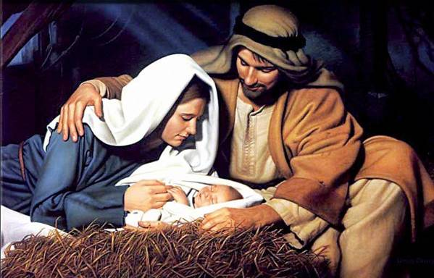
He would be born from a virgin (Isa. 7:14) and born in Bethlehem (Mica 5:2).

Slide 26
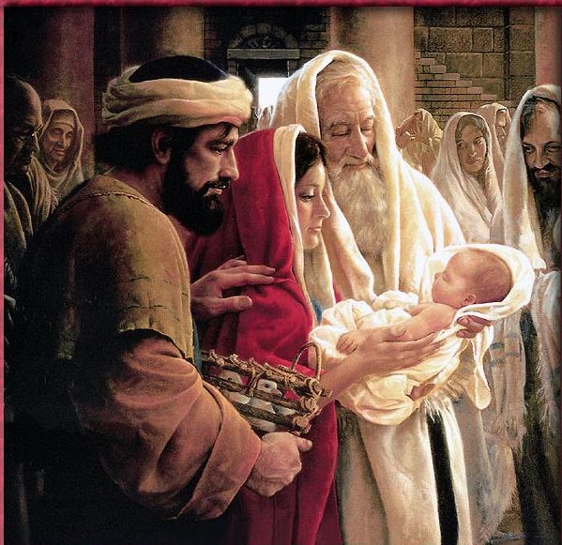
40 days later, Joseph and Mary take Jesus to the temple to present Him to the Lord and offer up two turtle doves (Luke 2).

Slide 27
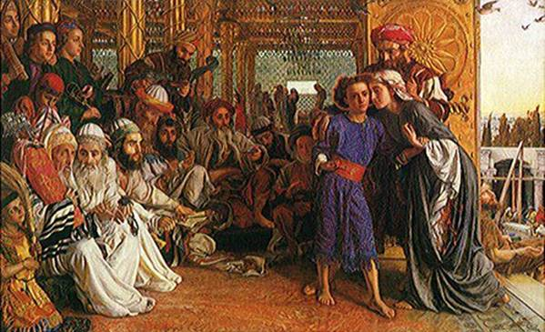
Jesus at the temple at age 12

Slide 28
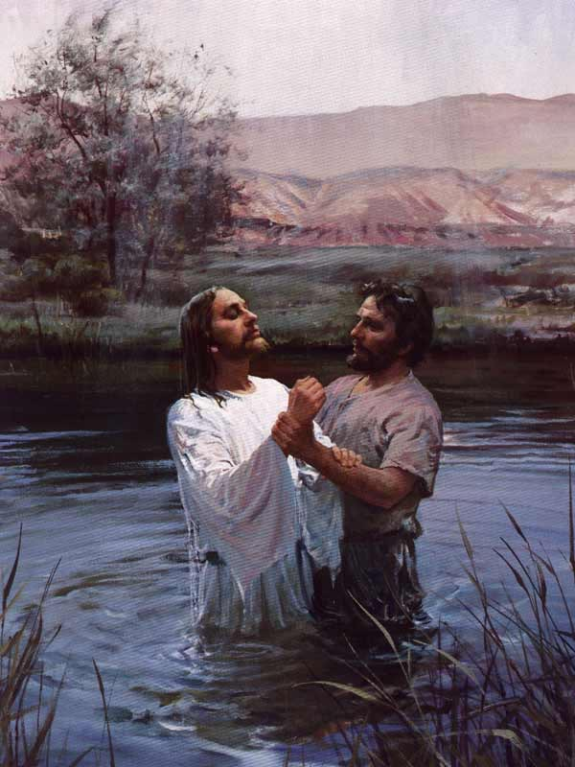
Jesus is baptized by John the Baptist

Slide 29
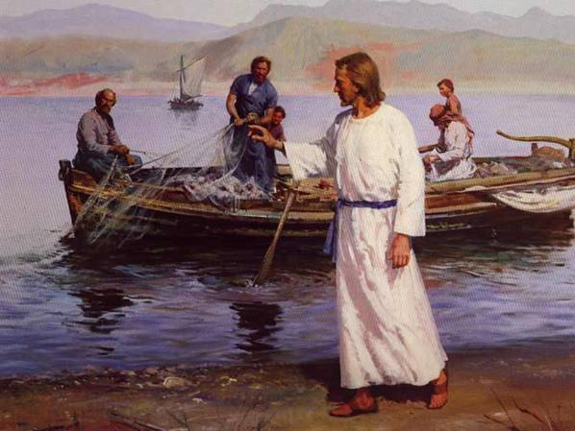
Jesus finds men to follow Him.

Slide 30
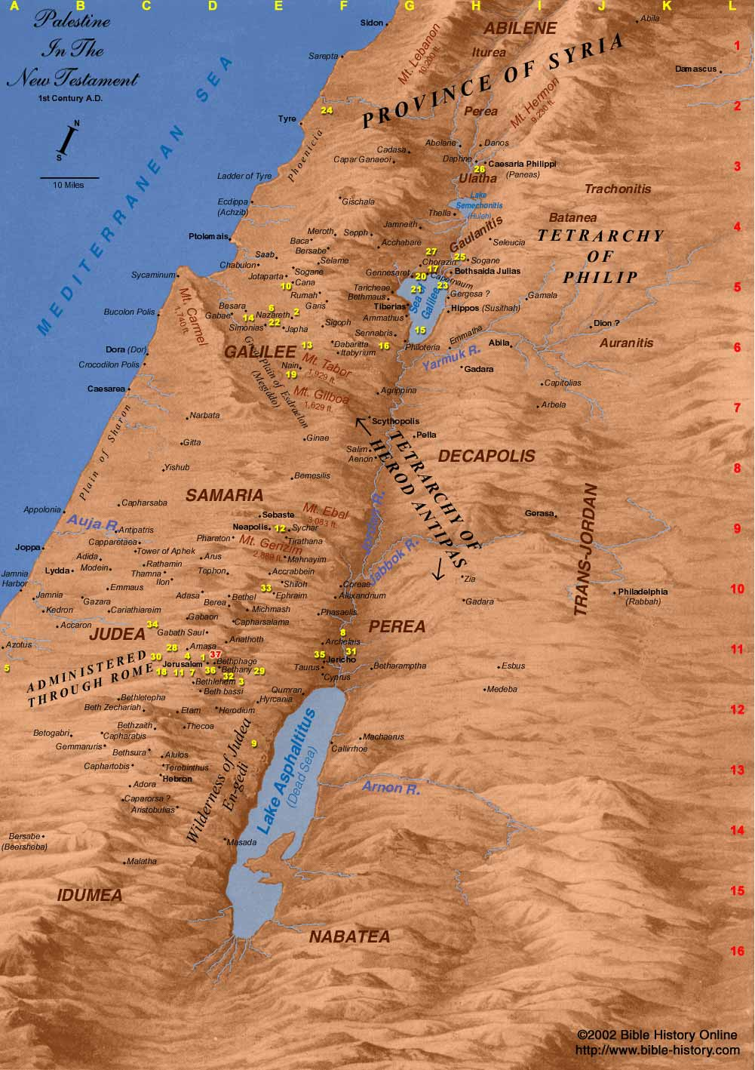

Slide 31
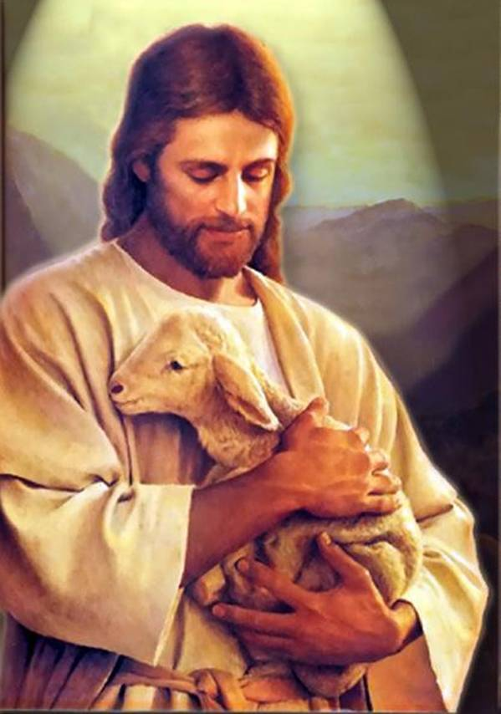
Jesus did many wonderful things that showed His love and compassion for the people.

Slide 32
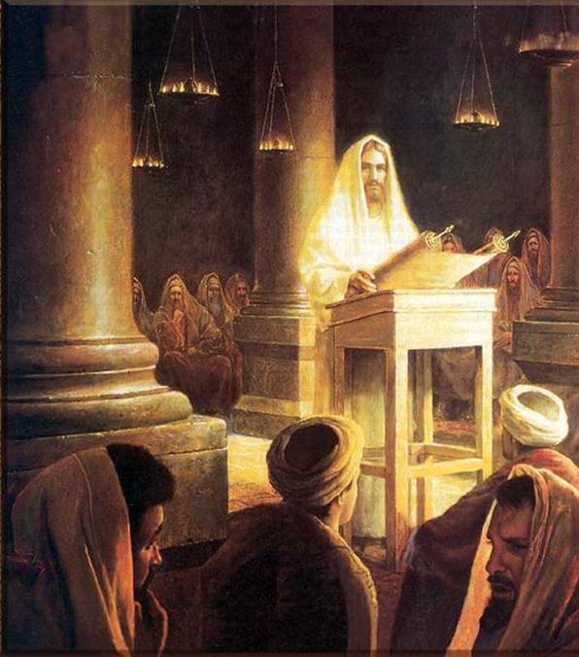
Jesus took many opportunities to teach the people including those Jews who opposed Him.

Slide 33
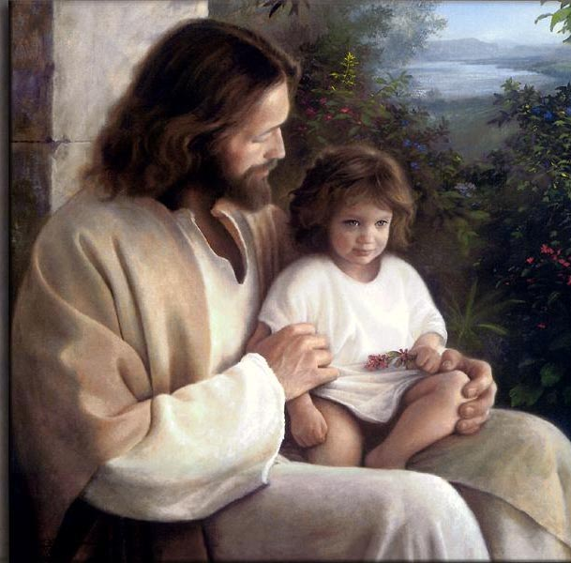
One lesson Jesus taught is that we all must become like little children.

Slide 34
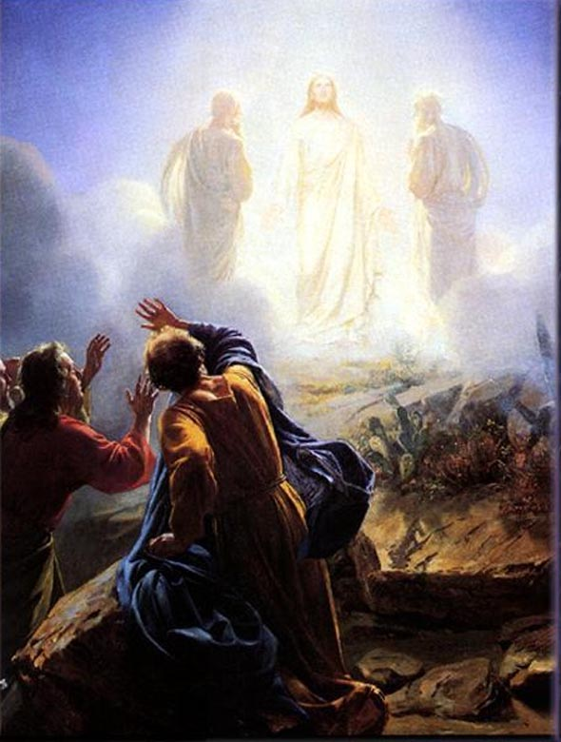
Another significant event in the life of Christ was transfiguration.

Slide 35
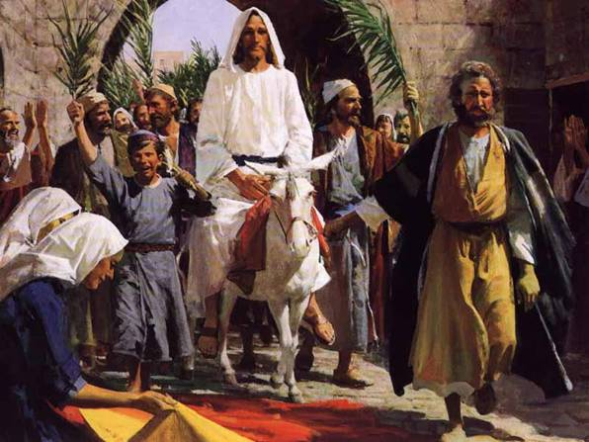
The triumphal entry into Jerusalem

Slide 36
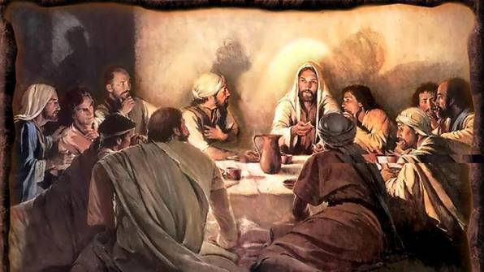
The last Passover meal before Jesus’ death.

Slide 37
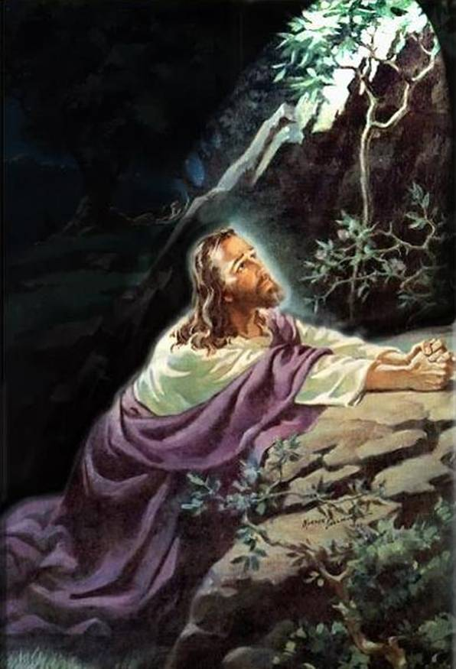
Jesus in the Garden of Gethsemane.

Slide 38
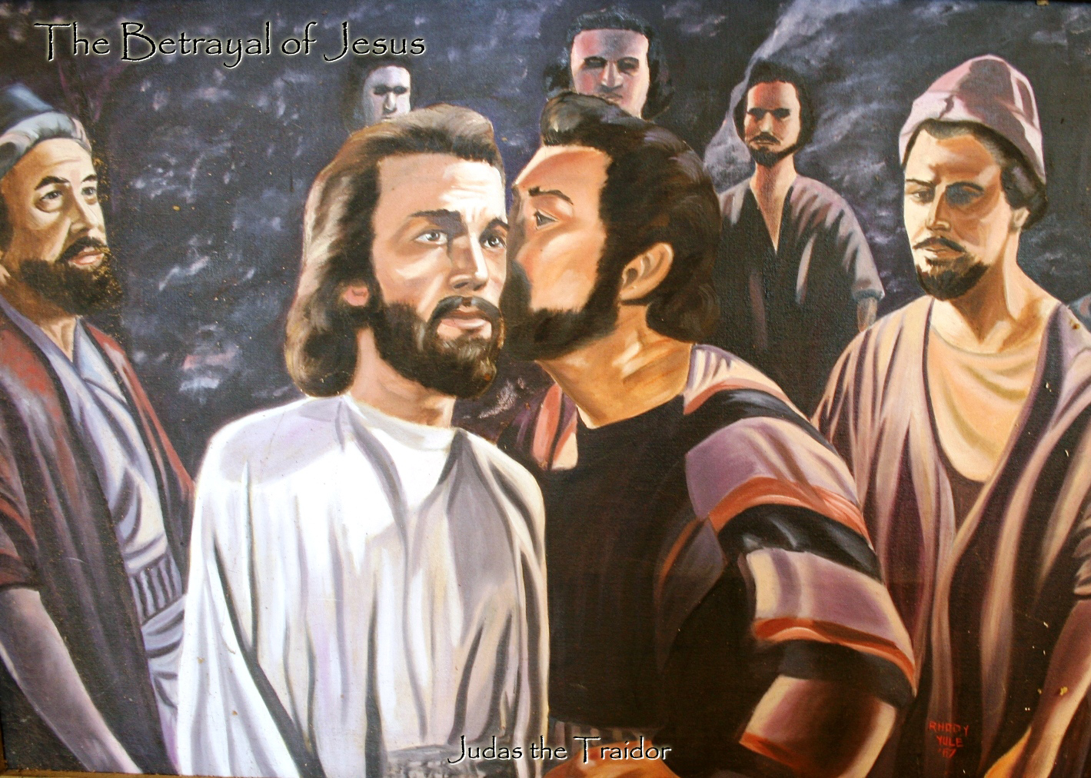

Slide 39
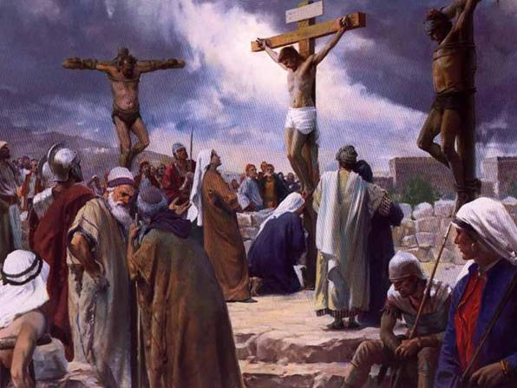
Jesus is crucified between two thieves.

Slide 40
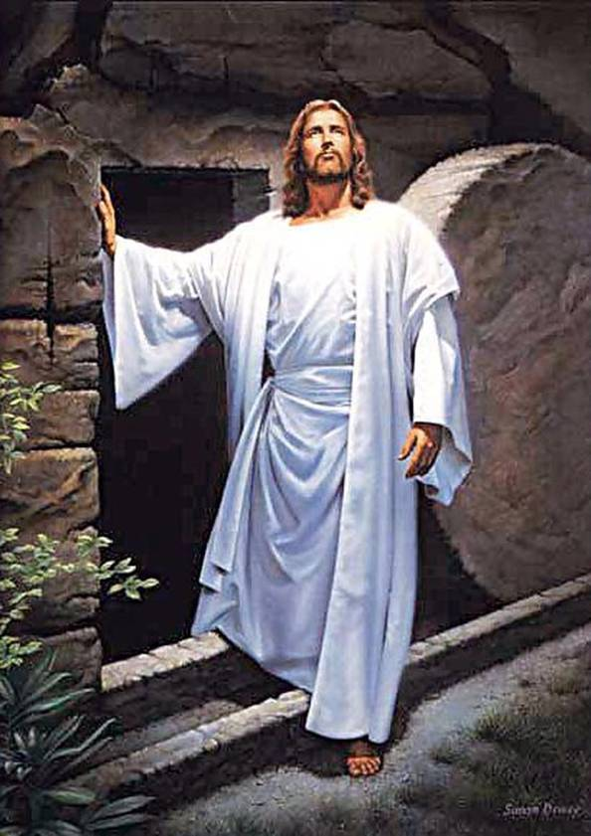
Jesus is raised from the dead on the 3rd day

Slide 41
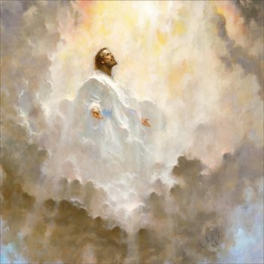
Jesus ascends to heaven

Slide 42
ONE SOLITARY LIFE
He was born in an obscure village The child of a peasant woman He grew up in another obscure village Where he worked in a carpenter shop Until he was thirty

Slide 43
He never wrote a book He never held an office He never went to college He never visited a big city He never travelled more than two hundred miles From the place where he was born He did none of the things Usually associated with greatness He had no credentials but himself

Slide 44
He was only thirty three His friends ran away One of them denied him He was turned over to his enemies And went through the mockery of a trial He was nailed to a cross between two thieves While dying, his executioners gambled for his clothing The only property he had on earth

Slide 45
When he was dead He was laid in a borrowed grave Through the pity of a friend

Slide 46
Nineteen centuries have come and gone And today Jesus is the central figure of the human race And the leader of mankind's progress All the armies that have ever marched All the navies that have ever sailed All the parliaments that have ever sat All the kings that ever reigned put together Have not affected the life of mankind on earth As powerfully as that one solitary life
Written by Dr James Allan in 1926.

