Slide 1
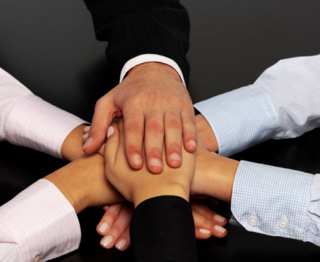
MY RESPONSIBILITY TO OTHERS Part 1

Slide 2
Romans 14:10 Why do you pass judgment on your brother? Or you, why do you despise your brother? For we will all stand before the judgment seat of God; ¹¹ for it is written, "As I live, says the Lord, every knee shall bow to me, and every tongue shall confess to God." ¹² So then each of us will give an account of himself to God.

Slide 3
2 Corinthians 5:9 So whether we are at home or away, we make it our aim to please him. ¹⁰ For we must all appear before the judgment seat of Christ, so that each one may receive what is due for what he has done in the body, whether good or evil.

Slide 4
1 Corinthians 9:24 Do you not know that those who run in a race all run, but one receives the prize? Run in such a way that you may obtain it. ²⁵ And everyone who competes for the prize is temperate in all things. Now they do it to obtain a
perishable crown, but we for an imperishable crown. ²⁶ Therefore I run thus: not with uncertainty. Thus I fight: not as one who beats the air. ²⁷ But I discipline my body and bring it into subjection, lest, when I have preached to others, I myself should become disqualified.

Slide 5
I must love and serve other Christians
Galatians 5:13 For you, brethren, have been called to liberty; only do not use liberty as an opportunity for the flesh, but through love serve one another.

Slide 6
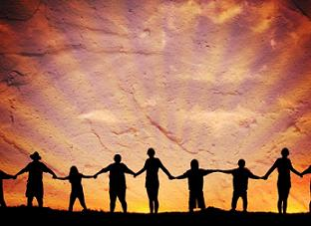
John 13:35 "By this all will know that you are My disciples, if you have love for one another."

Slide 7
John 13:3 Jesus, knowing that the Father had given all things into His hands, and that He had come from God and was going to God, ⁴ rose from supper and laid aside His garments, took a towel and girded Himself. ⁵ After that, He poured water into a basin and began to wash the disciples' feet, and to wipe them with the towel with which He was girded. ⁶ Then He came to Simon Peter. And Peter said to Him, "Lord, are You washing my feet?" ⁷ Jesus answered and said to him, "What I am doing you do not understand now, but you will know after this." ⁸ Peter said to Him, "You shall never wash my feet!" Jesus answered him, "If I do not wash you, you have no part with Me." ⁹ Simon Peter said to Him, "Lord, not my feet only, but also my hands and my head!"

Slide 8
¹⁰ Jesus said to him, "He who is bathed needs only to wash his feet, but is completely clean; and you are clean, but not all of you." ¹¹ For He knew who would betray Him; therefore He said, "You are not all clean." ¹² So when He had washed their feet, taken His garments, and sat down again, He said to them, "Do you know what I have done to you? ¹³ "You call me Teacher and Lord, and you say well, for so I am. ¹⁴ "If I then, your Lord and Teacher, have washed your feet, you also ought to wash one another's feet. ¹⁵ "For I have given you an example, that you should do as I have done to you. ¹⁶ "Most assuredly, I say to you, a servant is not greater than his master; nor is he who is sent greater than he who sent him. ¹⁷ "If you know these things, blessed are you if you do them.

Slide 9
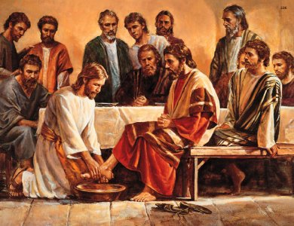

Slide 10
Mark 10:43 … whoever desires to become great among you shall be your servant. ⁴⁴ "And whoever of you desires to be first shall be slave of all. ⁴⁵ "For even the Son of Man did not come to be served, but to serve, and to give His life a ransom for many."

Slide 11
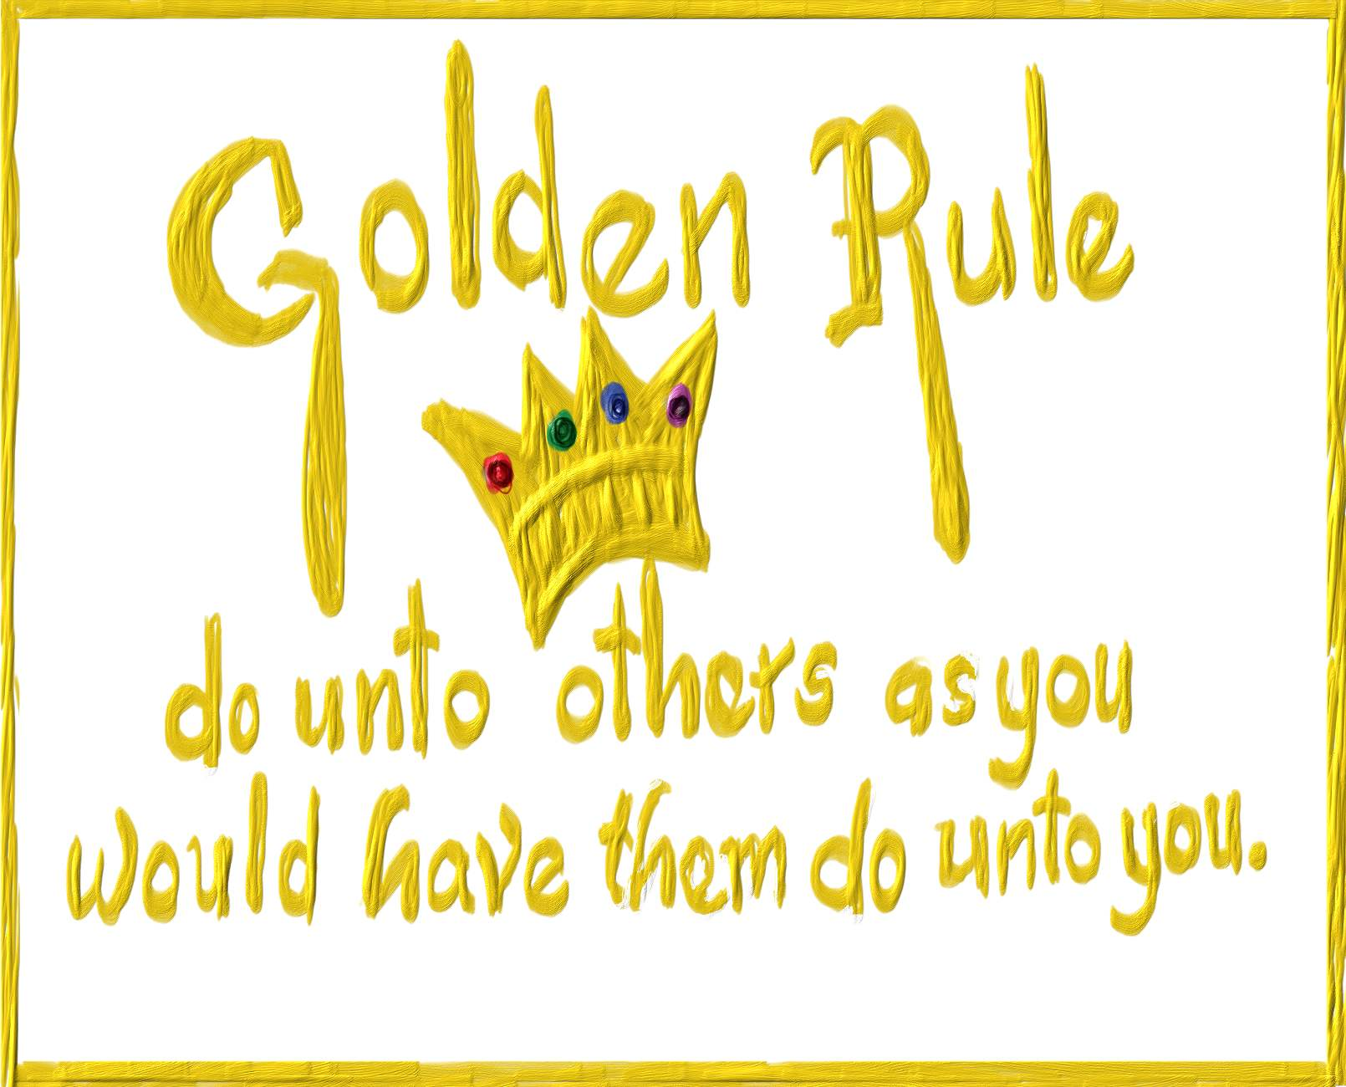
2. I must practice the Golden Rule
Matthew 7:12 "Therefore, whatever you want men to do to you, do also to them, for this is the Law and the Prophets.

Slide 12
Philippians 2:3 Let nothing be done through selfish ambition or conceit, but in lowliness of mind let each esteem others better than himself. ⁴ Let each of you look out not only for his own interests, but also for the interests of others. ⁵ Let this mind be in you which was also in Christ Jesus,

Slide 13
3. I must help build up the church

Slide 14
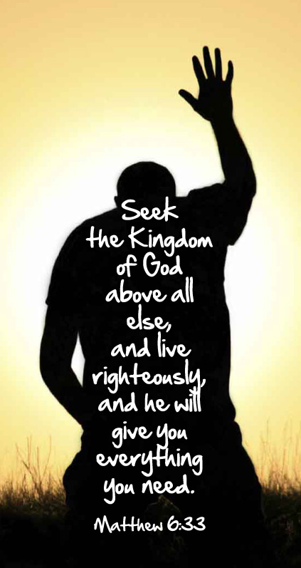
Matthew 6:33 "But seek first the kingdom of God and His righteousness, and all these things shall be added to you.

Slide 15
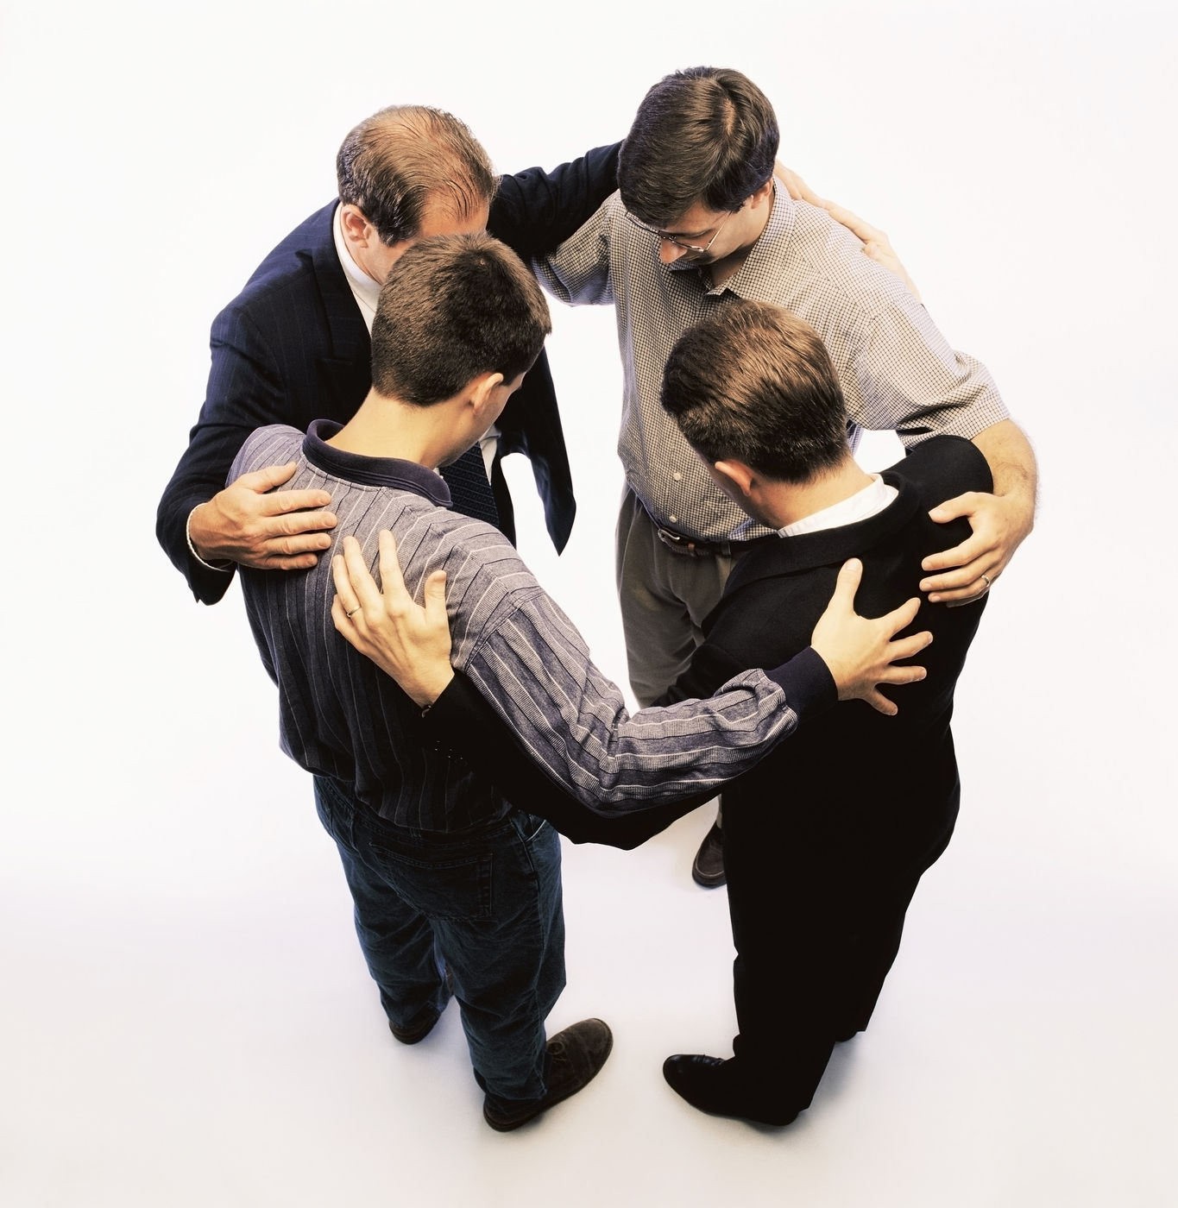
Hebrews 10:24 And let us consider one another in order to stir up love and good works, ²⁵ not forsaking the assembling of ourselves together, as is the manner of some, but exhorting one another, and so much the more as you see the Day approaching.

Slide 16
1 Corinthians 12:23 And those members of the body which we think to be less honorable, on these we bestow greater honor; and our unpresentable parts have greater modesty, ²⁴ but our presentable parts have no need. But God composed the body, having given greater honor to that part which lacks it, ²⁵ that there should be no schism in the body, but that the members should have the same care for one another. ²⁶ And if one member suffers, all the members suffer with it; or if one member is honored, all the members rejoice with it.

Slide 17
4. Our fourth point comes from:
1 Thessalonians 5:14 Now we exhort you, brethren, warn those who are unruly, comfort the fainthearted, uphold the weak, be patient with all. ¹⁵ See that no one renders evil for evil to anyone, but always pursue what is good both for yourselves and for all.

Slide 18
The word exhort has several meanings:
to address, speak to, (call to, call upon), which may be done in the way of exhortation, entreaty, comfort, instruction, etc. 2a) to admonish, exhort 2b) to beg, entreat, beseech 2b1) to strive to appease by entreaty 2c) to console, to encourage and strengthen by consolation, to comfort (Thayer)

Slide 19
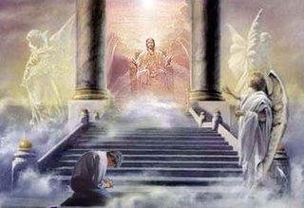
2 Corinthians 5:10 For we must all appear before the judgment seat of Christ, that each one may receive the things done in the body, according to what he has done,
whether good or bad. ¹¹ Knowing, therefore, the terror of the Lord, we persuade men;

Slide 20
Galatians 2:11 Now when Peter had come to Antioch, I withstood him to his face, because he was to be blamed; ¹² for before certain men came from James, he would eat with the Gentiles; but when they came, he withdrew and separated himself, fearing those who were of the circumcision. ¹³ And the rest of the Jews also played the hypocrite with him, so that even Barnabas was carried away with their hypocrisy. ¹⁴ But when I saw that they were not straightforward about the truth of the gospel, I said to Peter before them all, "If you, being a Jew, live in the manner of Gentiles and not as the Jews, why do you compel Gentiles to live as Jews?

Slide 21
¹⁵ "We who are Jews by nature, and not sinners of the Gentiles, ¹⁶ "knowing that a man is not justified by the works of the law but by faith in Jesus Christ, even we have believed in Christ Jesus, that we might be justified by faith in Christ and not by the works of the law; for by the works of the law no flesh shall be justified. ¹⁷ "But if, while we seek to be justified by Christ, we ourselves also are found sinners, is Christ therefore a minister of sin? Certainly not! ¹⁸ "For if I build again those things which I destroyed, I make myself a transgressor. ¹⁹ "For I through the law died to the law that I might live to God

Slide 22
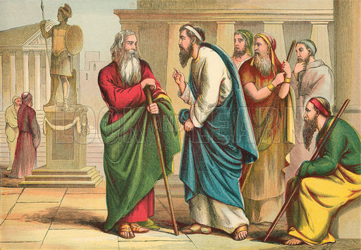
. ²⁰ "I have been crucified with Christ; it is no longer I who live, but Christ lives in me; and the life which I now live in the flesh I live by faith in the Son of God, who loved me and gave Himself for me. ²¹ "I do not set aside the grace of God; for if righteousness comes through the law, then Christ died in vain."

Slide 23
1 Thessalonians 5:14 Now we exhort you, brethren, warn those who are unruly, comfort the fainthearted, uphold the weak, be patient with all. ¹⁵ See that no one renders evil for evil to anyone, but always pursue what is good both for yourselves and for all.

Slide 24
¹⁵ See that no one renders evil for evil to anyone

Slide 25
but always pursue what is good both for yourselves and for all.

Slide 26
MY RESPONSIBILITY TO OTHERS Part 2

Slide 27
1. I must love and serve other Christians
2. I must practice the Golden Rule
3. I must help build up the church
4. Our fourth point comes from:
1 Thessalonians 5:14 Now we exhort you, brethren, warn those who are unruly, comfort the fainthearted, uphold the weak, be patient with all. ¹⁵ See that no one renders evil for evil to anyone, but always pursue what is good both for yourselves and for all.

Slide 28
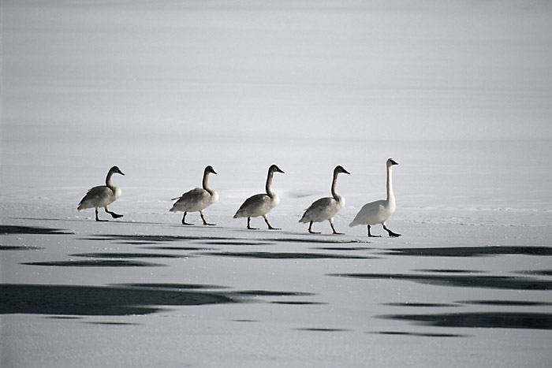
1. I must be a good example for others to follow

Slide 29
ESV 1 Timothy 4:12 Let no one despise you for your youth, but set the believers an example in speech, in conduct, in love, in faith, in purity. ¹³ Until I come, devote yourself to the public reading of Scripture, to exhortation, to teaching.

Slide 30
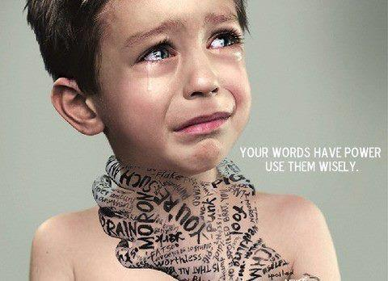
Proverbs 18:21 Death and life are in the power of the tongue.

Slide 31
Proverbs 21:23 Whoever guards his mouth and tongue Keeps his soul from troubles.
Proverbs 16:23 The heart of the wise teaches his mouth, And adds learning to his lips. 24 Pleasant words are like a honeycomb, Sweetness to the soul and health to the bones.

Slide 32
Colossians 4:6 Let your speech always be with grace, seasoned with salt, that you may know how you ought to answer each one.
Ephesians 4:29 Let no corrupt word proceed out of your mouth, but what is good for necessary edification, that it may impart grace to the hearers.

Slide 33
in
conduct,
in love,
in faith,
in purity.

Slide 34
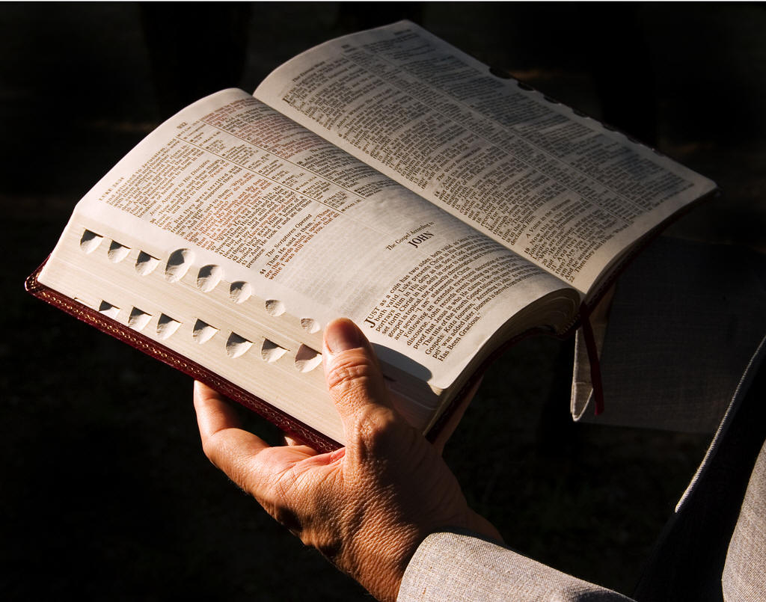
¹³ Until I come, devote yourself to the public reading of Scripture, to exhortation, to teaching.

Slide 35
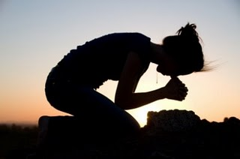
2. I must pray for others.

Slide 36
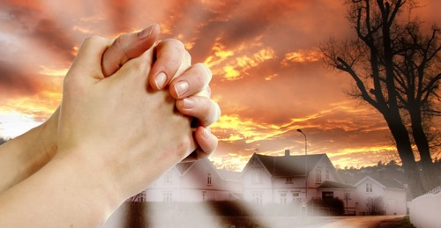
Hebrews 4:15 For we do not have a High Priest who cannot sympathize with our weaknesses, but was in all points tempted as we are, yet without sin. ¹⁶ Let us therefore come boldly to the throne of grace, that we may obtain mercy and find grace to help in time of need.

Slide 37
James 5:16 Confess your trespasses to one another, and pray for one another, that you may be healed. The effective, fervent prayer of a righteous man avails much.
Colossians 1:9 For this reason we also, since the day we heard it, do not cease to pray for you, and to ask that you may be filled with the knowledge of His will in all wisdom and spiritual understanding;

Slide 38
Hebrews 13:18 Pray for us; for we are confident that we have a good conscience, in all things desiring to live honorably.
1 Timothy 2:1 Therefore I exhort first of all that supplications, prayers, intercessions, and giving of thanks be made for all men, ² for kings and all who are in authority, that we may lead a quiet and peaceable life in all godliness and reverence. ³ For this is good and acceptable in the sight of God our Savior,

Slide 39
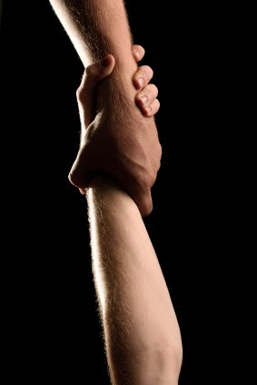
3. I must do what I can to restore the fallen

Slide 40
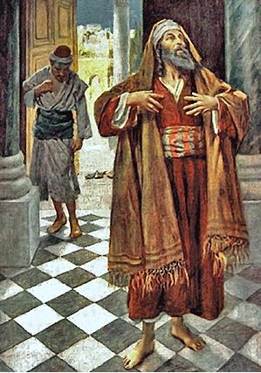
Luke 18:11 "The Pharisee stood and prayed thus with himself, 'God, I thank You that I am not like other men -- extortioners, unjust, adulterers, or even as this tax collector. ¹² 'I fast twice a week; I give tithes of all that I possess.'

Slide 41
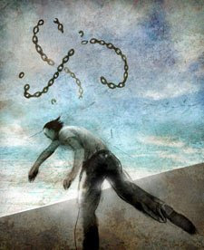
James 5:19 Brethren, if anyone among you wanders from the truth, and someone turns him back, ²⁰ let him know that he who turns a sinner from the error of his way will save a soul from death and cover a multitude of sins.

Slide 42
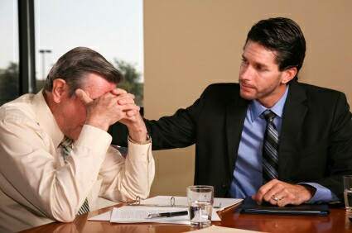
Galatians 6:1 Brethren, if a man is overtaken in any trespass, you who are spiritual restore such a one in a spirit of gentleness, considering yourself lest you also be tempted. ² Bear one another's burdens, and so fulfill the law of Christ.

Slide 43
4. I must be ready to forgive those who repent

Slide 44
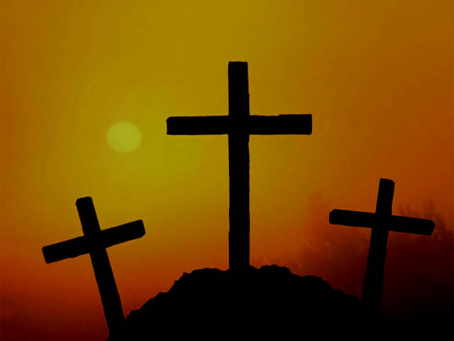
Romans 5:6 For when we were still without strength, in due time Christ died for the ungodly. ⁷ For scarcely for a righteous man will one die; yet perhaps for a good man someone would even dare to die. ⁸ But God demonstrates His own love toward us, in that while we were still sinners, Christ died for us. ⁹ Much more then, having now been justified by His blood, we shall be saved from wrath through Him.

Slide 45
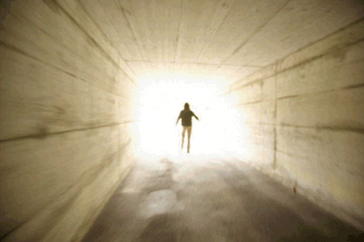
1 John 1:7 But if we walk in the light as He is in the light, we have fellowship with one another, and the blood of Jesus Christ His Son cleanses us from all sin
⁸ If we say that we have no sin, we deceive ourselves, and the truth is not in us. ⁹ If we confess our sins, He is faithful and just to forgive us our sins and to cleanse us from all unrighteousness.

Slide 46
Luke 17:3 "Take heed to yourselves. If your brother sins against you, rebuke him; and if he repents, forgive him. ⁴ "And if he sins against you seven times in a day, and seven times in a day returns to you, saying, 'I repent,' you shall forgive him."
Mark 11:25 " And whenever you stand praying, if you have anything against anyone, forgive him, that your Father in heaven may also forgive you your trespasses. ²⁶ "But if you do not forgive, neither will your Father in heaven forgive your trespasses."

Slide 47
Matthew 18:23 "Therefore the kingdom of heaven is like a certain king who wanted to settle accounts with his servants. ²⁴ "And when he had begun to settle accounts, one was brought to him who owed him ten thousand talents. ²⁵ "But as he was not able to pay, his master commanded that he be sold, with his wife and children and all that he had, and that payment be made. ²⁶ "The servant therefore fell down before him, saying, 'Master, have patience with me, and I will pay you all.' ²⁷ "Then the master of that servant was moved with compassion, released him, and forgave him the debt. ²⁸ "But that servant went out and found one of his fellow servants who owed him a hundred denarii; and he laid hands on him and took him by the throat, saying, 'Pay me what you owe!'

Slide 48
²⁹ "So his fellow servant fell down at his feet and begged him, saying, 'Have patience with me, and I will pay you all.' ³⁰ "And he would not, but went and threw him into prison till he should pay the debt. ³¹ "So when his fellow servants saw what had been done, they were very grieved, and came and told their master all that had been done. ³² "Then his master, after he had called him, said to him, 'You wicked servant! I forgave you all that debt because you begged me. ³³ 'Should you not also have had compassion on your fellow servant, just as I had pity on you?' ³⁴ "And his master was angry, and delivered him to the torturers until he should pay all that was due to him. ³⁵ "So My heavenly Father also will do to you if each of you, from his heart, does not forgive his brother his trespasses."

Slide 49
1 Peter 2:17
Honor all people.
Love the brotherhood.
Fear God.
Honor the king.

