Slide 1
LEARNING FROM A POSTAGE STAMP

Slide 2
1. A postage stamp is made and did not just happen.

Slide 3
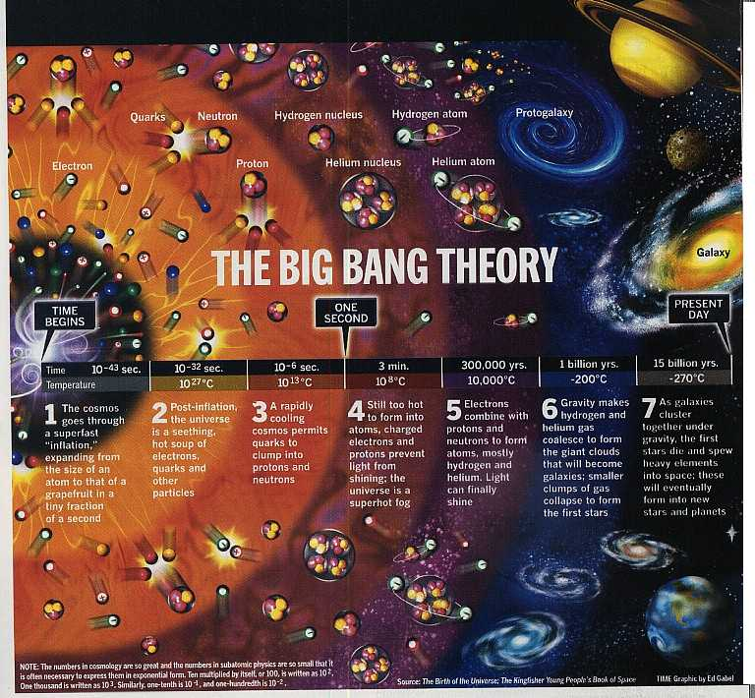

Slide 4
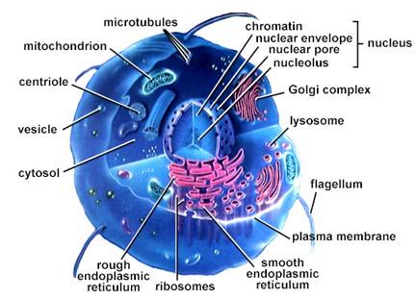

Slide 5
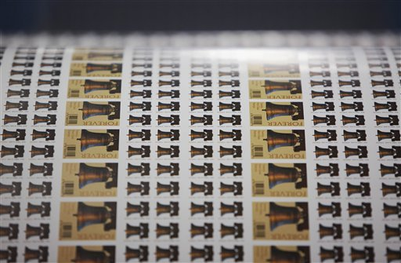

Slide 6
Genesis 1:1 ¶ In the beginning God created the heavens and the earth. ² The earth was without form, and void; and darkness was on the face of the deep. And the Spirit of God was hovering over the face of the waters. ³ Then God said, "Let there be light"; and there was light. ⁴ And God saw the light, that it was good; and God divided the light from the darkness. ⁵ God called the light Day, and the darkness He called Night. So the evening and the morning were the first day.

Slide 7
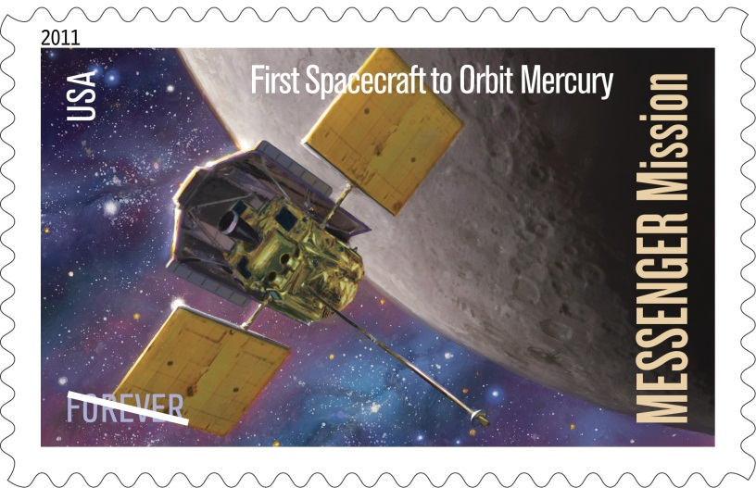
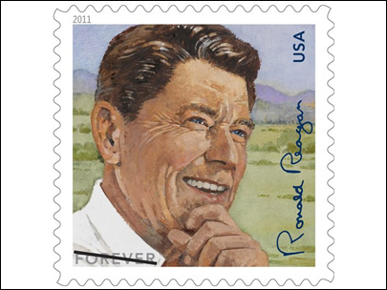
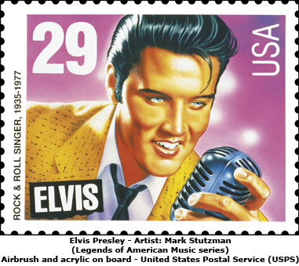
2. It bears the image of someone or some great event most of the time.

Slide 8
Genesis 1:26 Then God said, "Let Us make man in Our image, according to Our likeness; let them have dominion over the fish of the sea, over the birds of the air, and over the cattle, over all the earth and over every creeping thing that creeps on the earth." ²⁷ So God created man in His own image; in the image of God He created him; male and female He created them. ²⁸ Then God blessed them, and God said to them, "Be fruitful and multiply; fill the earth and subdue it; have dominion over the fish of the sea, over the birds of the air, and over every living thing that moves on the earth."

Slide 9
²⁹ And God said, "See, I have given you every herb that yields seed which is on the face of all the earth, and every tree whose fruit yields seed; to you it shall be for food. ³⁰ "Also, to every beast of the earth, to every bird of the air, and to everything that creeps on the earth, in which there is life, I have given every green herb for food"; and it was so. ³¹ Then God saw everything that He had made, and indeed it was very good. So the evening and the morning were the sixth day.

Slide 10
Hebrews 1:1 God, who at various times and in various ways spoke in time past to the fathers by the prophets, ² has in these last days spoken to us by His Son, whom He has appointed heir of all things, through whom also He made the worlds; ³ who being the brightness of His glory and the express image of His person, and upholding all things by the word of His power, when He had by Himself purged our sins, sat down at the right hand of the Majesty on high, ⁴ having become so much better than the angels, as He has by inheritance obtained a more excellent name than they.

Slide 11
1 Peter 2:21 For to this you were called, because Christ also suffered for us, leaving us an example, that you should follow His steps: ²² "Who committed no sin, Nor was deceit found in His mouth"; ²³ who, when He was reviled, did not revile in return; when He suffered, He did not threaten, but committed Himself to Him who judges righteously; ²⁴ who Himself bore our sins in His own body on the tree, that we, having died to sins, might live for righteousness -- by whose stripes you were healed.

Slide 12
1 Timothy 4:12 Let no one despise your youth, but be an example to the believers in word, in conduct, in love, in spirit, in faith, in purity. ¹³ Till I come, give attention to reading, to exhortation, to doctrine.

Slide 13
3. They are made by those in authority and governed by that same authority.

Slide 14
Matthew 28:18 And Jesus came and spoke to them, saying, "All authority has been given to Me in heaven and on earth. ¹⁹ "Go therefore and make disciples of all the nations, baptizing them in the name of the Father and of the Son and of the Holy Spirit, ²⁰ "teaching them to observe all things that I have commanded you; and lo, I am with you always, even to the end of the age." Amen.

Slide 15
1 Corinthians 15:27 For "He (the Father) has put all things under His (Jesus) feet." But when He (the Father) says "all things are put under Him (Jesus)," it is evident that He (the Father) who put all things under Him (Jesus) is excepted. ²⁸ Now when all things are made subject to Him (Jesus), then the Son Himself will also be subject to Him (the Father) who put all things under Him (Jesus), that God may be all in all.

Slide 16
2 Timothy 3:16 All Scripture is given by inspiration of God, and is profitable for doctrine, for reproof, for correction, for instruction in righteousness, ¹⁷ that the man of God may be complete, thoroughly equipped for every good work.
2 Peter 1:3 as His divine power has given to us all things that pertain to life and godliness, through the knowledge of Him who called us by glory and virtue,

Slide 17
John 5:19 Then Jesus answered and said to them, "Most assuredly, I say to you, the Son can do nothing of Himself, but what He sees the Father do; for whatever He does, the Son also does in like manner.
Hebrews 5:8 though He was a Son, yet He learned obedience by the things which He suffered. ⁹ And having been perfected, He became the author of eternal salvation to all who obey Him,

Slide 18
2 Thessalonians 1:7 when the Lord Jesus is revealed from heaven with His mighty angels, ⁸ in flaming fire taking vengeance on those who do not know God, and on those who do not obey the gospel of our Lord Jesus Christ. ⁹ These shall be punished with everlasting destruction from the presence of the Lord and from the glory of His power,
2 John 1:9 Whoever transgresses and does not abide in the doctrine of Christ does not have God. He who abides in the doctrine of Christ has both the Father and the Son.

Slide 19
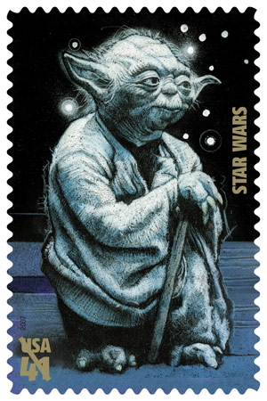
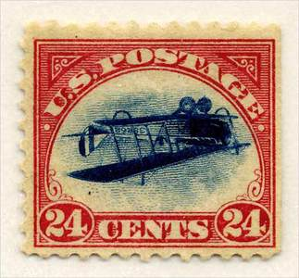
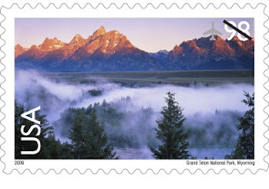
4. Its appearance does not limit its ability to carry out its task.

Slide 20
Mark 14:3 And being in Bethany at the house of Simon the leper, as He sat at the table, a woman came having an alabaster flask of very costly oil of spikenard. Then she broke the flask and poured it on His head. ⁴ But there were some who were indignant among themselves, and said, "Why was this fragrant oil wasted? ⁵ "For it might have been sold for more than three hundred denarii and given to the poor." And they criticized her sharply. ⁶ But Jesus said, "Let her alone. Why do you trouble her? She has done a good work for Me. ⁷ "For you have the poor with you always, and whenever you wish you may do them good; but Me you do not have always. ⁸ "She has done what she could. She has come beforehand to anoint My body for burial. ⁹ "Assuredly, I say to you, wherever this gospel is preached in the whole world, what this woman has done will also be told as a memorial to her."

Slide 21
2 Corinthians 8:1 Moreover, brethren, we make known to you the grace of God bestowed on the churches of Macedonia: ² that in a great trial of affliction the abundance of their joy and their deep poverty abounded in the riches of their liberality. ³ For I bear witness that according to their ability, yes, and beyond their ability, they were freely willing, ⁴ imploring us with much urgency that we would receive the gift and the fellowship of the ministering to the saints. ⁵ And not only as we had hoped, but they first gave themselves to the Lord, and then to us by the will of God.

Slide 22
1 Samuel 16:7 But the LORD said to Samuel, "Do not look at his appearance or at the height of his stature, because I have refused him. For the Lord does not see as man sees; for man looks at the outward appearance, but the LORD looks at the heart."

Slide 23
We learned that a stamp is created and so were we.
We learned that a stamp bears an image, and we bear the image of God.
We learned that stamps are regulated by law, and we are regulated by the law of God.
We learned that stamps come in different shapes, sizes and vary in appearance, yet they get the job done. We too come in different shapes, sizes and vary in appearance, yet we can get the job done for our Lord by doing what we can.

Slide 24
LEARNING FROM A POSTAGE STAMP Part 2

Slide 25
We learned that a stamp is created and so were we.
We learned that a stamp bears an image, and we bear the image of God.
We learned that stamps are regulated by law, and we are regulated by the law of God.
We learned that stamps come in different shapes, sizes and vary in appearance, yet they get the job done. We too come in different shapes, sizes and vary in appearance, yet we can get the job done for our Lord by doing what we can.

Slide 26
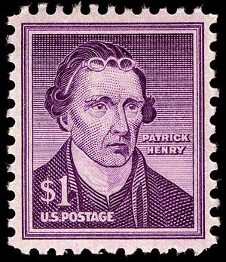
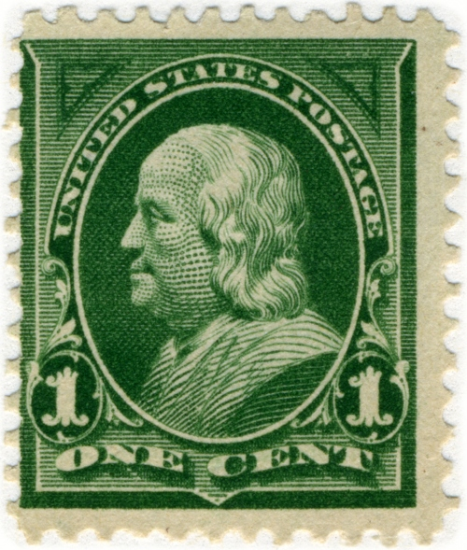
5. Stamps have different values.

Slide 27
Matthew 25:14 " For the kingdom of heaven is like a man traveling to a far country, who called his own servants and delivered his goods to them. ¹⁵ "And to one he gave five talents, to another two, and to another one, to each according to his own ability; and immediately he went on a journey. ¹⁶ "Then he who had received the five talents went and traded with them, and made another five talents. ¹⁷ "And likewise he who had received two gained two more also. ¹⁸ "But he who had received one went and dug in the ground, and hid his lord's money. ¹⁹ "After a long time the lord of those servants came and settled accounts with them.

Slide 28
²⁰ "So he who had received five talents came and brought five other talents, saying, 'Lord, you delivered to me five talents; look, I have gained five more talents besides them.' ²¹ "His lord said to him, 'Well done, good and faithful servant; you were faithful over a few things, I will make you ruler over many things. Enter into the joy of your lord.' ²² "He also who had received two talents came and said, 'Lord, you delivered to me two talents; look, I have gained two more talents besides them.' ²³ "His lord said to him, 'Well done, good and faithful servant; you have been faithful over a few things, I will make you ruler over many things. Enter into the joy of your lord.'

Slide 29
²⁴ "Then he who had received the one talent came and said, 'Lord, I knew you to be a hard man, reaping where you have not sown, and gathering where you have not scattered seed. ²⁵ 'And I was afraid, and went and hid your talent in the ground. Look, there you have what is yours.' ²⁶ "But his lord answered and said to him, 'You wicked and lazy servant, you knew that I reap where I have not sown, and gather where I have not scattered seed. ²⁷ 'So you ought to have deposited my money with the bankers, and at my coming I would have received back my own with interest. ²⁸ 'Therefore take the talent from him, and give it to him who has ten talents.

Slide 30
²⁹ 'For to everyone who has, more will be given, and he will have abundance; but from him who does not have, even what he has will be taken away. ³⁰ 'And cast the unprofitable servant into the outer darkness. There will be weeping and gnashing of teeth.'

Slide 31
1 Corinthians 12:13 For by one Spirit we were all baptized into one body -- whether Jews or Greeks, whether slaves or free -- and have all been made to drink into one Spirit. ¹⁴ ¶ For in fact the body is not one member but many. ¹⁵ If the foot should say, "Because I am not a hand, I am not of the body," is it therefore not of the body? ¹⁶ And if the ear should say, "Because I am not an eye, I am not of the body," is it therefore not of the body? ¹⁷ If the whole body were an eye, where would be the hearing? If the whole were hearing, where would be the smelling? ¹⁸ But now God has set the members, each one of them, in the body just as He pleased.

Slide 32
¹⁹ And if they were all one member, where would the body be? ²⁰ But now indeed there are many members, yet one body. ²¹ And the eye cannot say to the hand, "I have no need of you"; nor again the head to the feet, "I have no need of you." ²² No, much rather, those members of the body which seem to be weaker are necessary. ²³ And those members of the body which we think to be less honorable, on these we bestow greater honor; and our unpresentable parts have greater modesty, ²⁴ but our presentable parts have no need. But God composed the body, having given greater honor to that part which lacks it,

Slide 33
²⁵ that there should be no schism in the body, but that the members should have the same care for one another. ²⁶ And if one member suffers, all the members suffer with it; or if one member is honored, all the members rejoice with it.

Slide 34
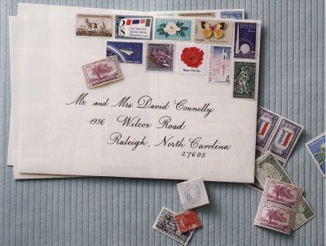
6. Stamps work well together.

Slide 35
John 17:20 " I do not pray for these alone, but also for those who will believe in Me through their word; ²¹ "that they all may be one, as You, Father, are in Me, and I in You; that they also may be one in Us, that the world may believe that You sent Me. ²² "And the glory which You gave Me I have given them, that they may be one just as We are one:

Slide 36
1 Corinthians 1:10 Now I plead with you, brethren, by the name of our Lord Jesus Christ, that you all speak the same thing, and that there be no divisions among you, but that you be perfectly joined together in the same mind and in the same judgment.

Slide 37
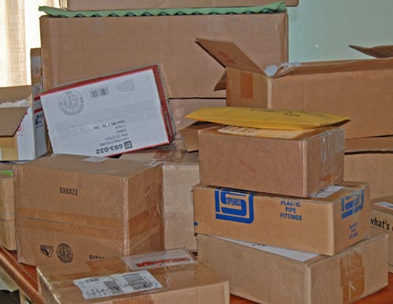
7. A stamp will work anywhere you put it.

Slide 38
Acts 8:1 Now Saul was consenting to his death. At that time a great persecution arose against the church which was at Jerusalem; and they were all scattered throughout the regions of Judea and Samaria, except the apostles. ² And devout men carried Stephen to his burial, and made great lamentation over him. ³ As for Saul, he made havoc of the church, entering every house, and dragging off men and women, committing them to prison. ⁴ Therefore those who were scattered went everywhere preaching the word.

Slide 39
Romans 1:14 I am a debtor both to Greeks and to barbarians, both to wise and to unwise. ¹⁵ So, as much as is in me, I am ready to preach the gospel to you who are in Rome also. ¹⁶ ¶ For I am not ashamed of the gospel of Christ, for it is the power of God to salvation for everyone who believes, for the Jew first and also for the Greek. ¹⁷ For in it the righteousness of God is revealed from faith to faith; as it is written, "The just shall live by faith."

Slide 40
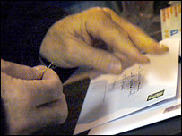
8. A stamp must be licked and pressed on for it to stick.

Slide 41
2 Timothy 2:1 You therefore, my son, be strong in the grace that is in Christ Jesus. ² And the things that you have heard from me among many witnesses, commit these to faithful men who will be able to teach others also. ³ You therefore must endure hardship as a good soldier of Jesus Christ. ⁴ No one engaged in warfare entangles himself with the affairs of this life, that he may please him who enlisted him as a soldier. ⁵ And also if anyone competes in athletics, he is not crowned unless he competes according to the rules. ⁶ The hard-working farmer must be first to partake of the crops.

Slide 42
⁷ Consider what I say, and may the Lord give you understanding in all things. ⁸ Remember that Jesus Christ, of the seed of David, was raised from the dead according to my gospel, ⁹ for which I suffer trouble as an evildoer, even to the point of chains; but the word of God is not chained. ¹⁰ Therefore I endure all things for the sake of the elect, that they also may obtain the salvation which is in Christ Jesus with eternal glory.

Slide 43
Revelation 2:10 "Do not fear any of those things which you are about to suffer. Indeed, the devil is about to throw some of you into prison, that you may be tested, and you will have tribulation ten days. Be faithful until death, and I will give you the crown of life.

Slide 44
9. A stamp must be purchased, placed on an envelope, and marked with approval before it will go anywhere.

Slide 45
1 Corinthians 6:20 For you were bought at a price; therefore glorify God in your body and in your spirit, which are God's.

Slide 46
Acts 2:38 Then Peter said to them, "Repent, and let every one of you be baptized in the name of Jesus Christ for the remission of sins; and you shall receive the gift of the Holy Spirit.

Slide 47
Ephesians 1:13 In Him you also trusted, after you heard the word of truth, the gospel of your salvation; in whom also, having believed, you were sealed with the Holy Spirit of promise, ¹⁴ who is the guarantee of our inheritance until the redemption of the purchased possession, to the praise of His glory.

Slide 48
BDAG defines seal: to mark with a seal as a means of identification, mark, seal… so that the mark denoting ownership also carries w. it the protection of the owner.

Slide 49
Matthew 28:19 "Go therefore and make disciples of all the nations, baptizing them in the name of the Father and of the Son and of the Holy Spirit,

Slide 50
Romans 8:16 The Spirit Himself bears witness with our spirit that we are children of God,

Slide 51
We learned that a stamp is created and so were we.
We learned that a stamp bears an image, and we bear the image of God.
We learned that stamps are regulated by law, and we are regulated by the law of God.
We learned that stamps come in different shapes, sizes and vary in appearance, yet they get the job done. We too come in different shapes, sizes and vary in appearance, yet we can get the job done for our Lord by doing what we can.

Slide 52
We learned that a stamp can have different values but it does not make one more important than the other. We all have different talents and each of them is important and makes the church stronger.
We learned that stamps work well together. Christians are to work together for a common goal and be unified based on God’s Word.
We learned that a stamp will work anywhere you put it and so should we.
We learned that a stamp must be licked and pressed on. Christians will have to endure hardships in life. The more we are pressed from hard times, the more our faith will grow and help us endure.

Slide 53
We learned that a stamp must be purchased, put on an envelope, and approved with a mark. We were purchased by the blood of Jesus and we are marked by the Holy Spirit as children of God when we obey the gospel, which includes being baptized in the name of Christ for the forgiveness of our sins.

