Slide 1
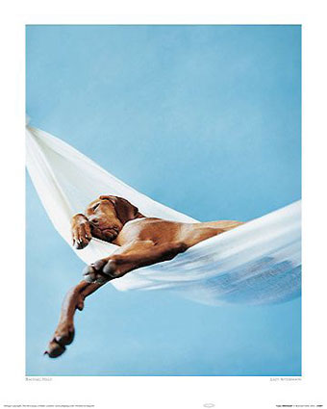
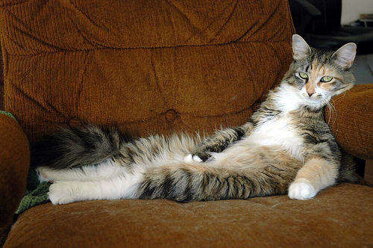
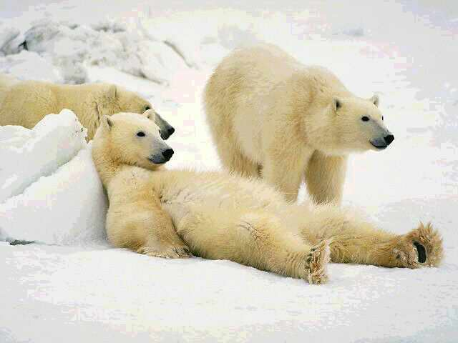
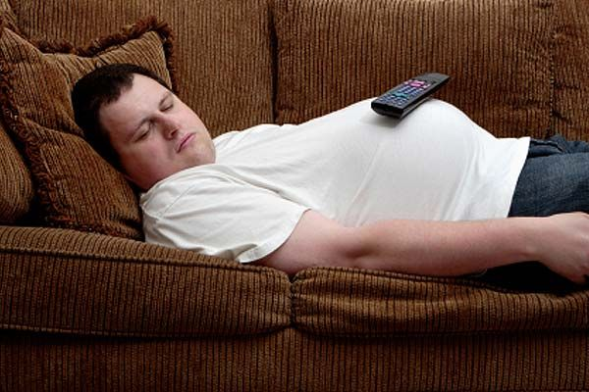
LAZINESS

Slide 2
Laziness - Inactivity resulting from a dislike of work - Apathy and inactivity in the practice of virtue

Slide 3
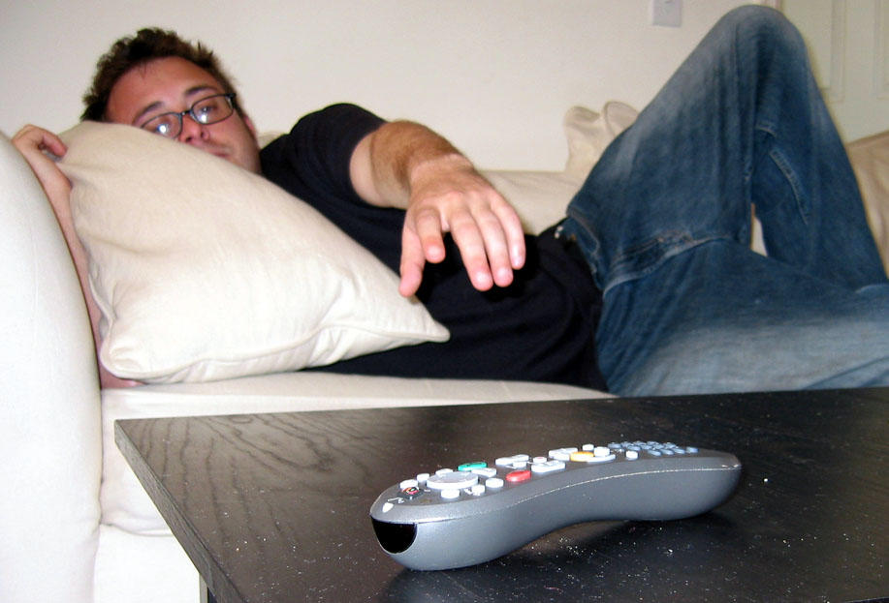

Slide 4
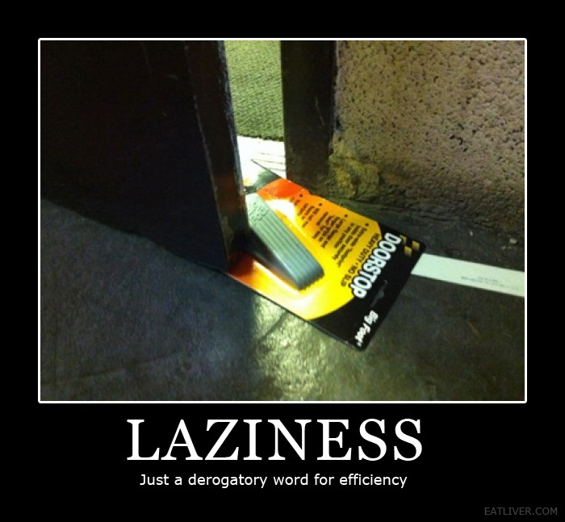

Slide 5
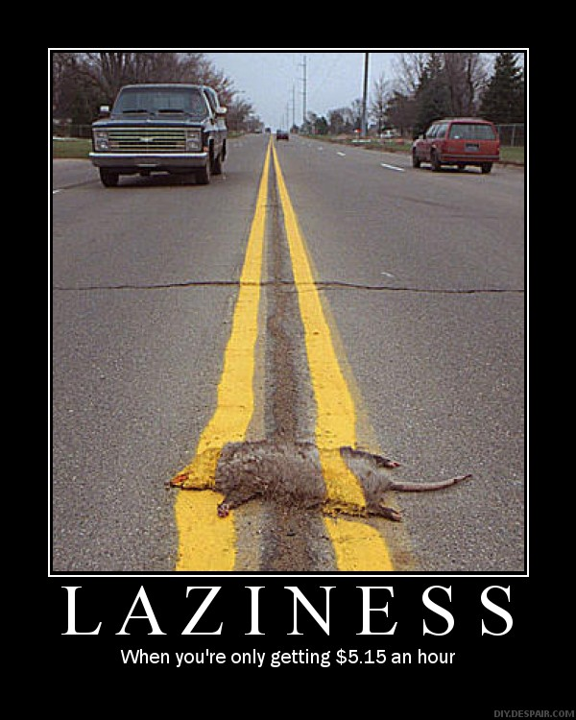
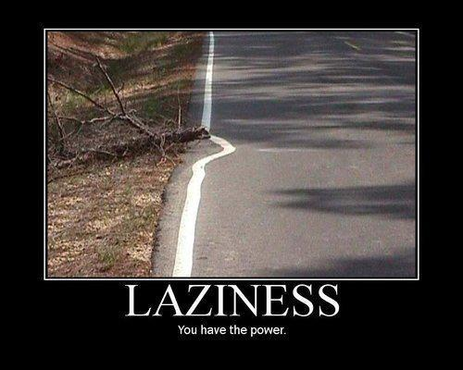

Slide 6
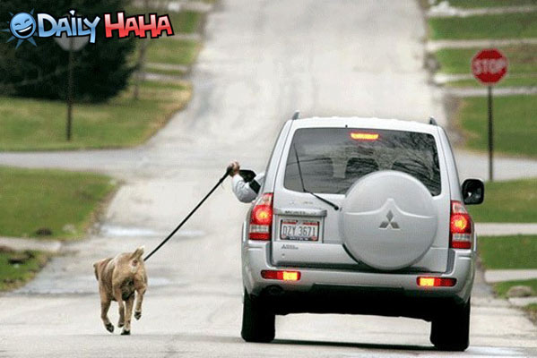

Slide 7
You know you’re lazy when you get excited about canceled plans.

Slide 8
Genesis 2:15 Then the LORD God took the man and put him in the garden of Eden to tend and keep it.

Slide 9
Genesis 3:17 Then to Adam He said, "Because you have heeded the voice of your wife, and have eaten from the tree of which I commanded you, saying, 'You shall not eat of it': "Cursed is the ground for your sake; In toil you shall eat of it All the days of your life. 18 Both thorns and thistles it shall bring forth for you, And you shall eat the herb of the field. 19 In the sweat of your face you shall eat bread Till you return to the ground, For out of it you were taken; For dust you are, And to dust you shall return."

Slide 10
1 Thessalonians 4:10 … But we urge you, brethren, that you increase more and more; 11 that you also aspire to lead a quiet life, to mind your own business, and to work with your own hands, as we commanded you, 12 that you may walk properly toward those who are outside, and that you may lack nothing.

Slide 11
2 Thessalonians 3:6 But we command you, brethren, in the name of our Lord Jesus Christ, that you withdraw from every brother who walks disorderly and not according to the tradition which he received from us. 7 For you yourselves know how you ought to follow us, for we were not disorderly among you; 8 nor did we eat anyone's bread free of charge, but worked with labor and toil night and day, that we might not be a burden to any of you, 9 not because we do not have authority, but to make ourselves an example of how you should follow us. 10 For even when we were with you, we commanded you this: If anyone will not work, neither shall he eat. 11 For we hear that there are some who walk among you in a disorderly manner, not working at all, but are busybodies. 12 Now those who are such we command and exhort through our Lord Jesus Christ that they work in quietness and eat their own bread. 13 But as for you, brethren, do not grow weary in doing good.

Slide 12
1 Timothy 5:8 But if anyone does not provide for his own, and especially for those of his household, he has denied the faith and is worse than an unbeliever.

Slide 13
Ecclesiastes 9:10 Whatever your hand finds to do, do it with your might;

Slide 14
Colossians 3:23And whatever you do, do it heartily, as to the Lord and not to men, 24 knowing that from the Lord you will receive the reward of the inheritance; for you serve the Lord Christ. 25 But he who does wrong will be repaid for what he has done, and there is no partiality.

Slide 15
Acts 26:20 "but declared first to those in Damascus and in Jerusalem, and throughout all the region of Judea, and then to the Gentiles, that they should repent, turn to God, and do works befitting repentance.
Romans 12:11 not lagging in diligence, fervent in spirit, serving the Lord;

Slide 16
Matthew 25:24 "Then he who had received the one talent came and said, 'Lord, I knew you to be a hard man, reaping where you have not sown, and gathering where you have not scattered seed. 25 'And I was afraid, and went and hid your talent in the ground. Look, there you have what is yours.' 26 "But his lord answered and said to him, 'You wicked and lazy servant, you knew that I reap where I have not sown, and gather where I have not scattered seed. 27 'So you ought to have deposited my money with the bankers, and at my coming I would have received back my own with interest. 28 'Therefore take the talent from him, and give it to him who has ten talents. 29 'For to everyone who has, more will be given, and he will have abundance; but from him who does not have, even what he has will be taken away. 30 'And cast the unprofitable servant into the outer darkness. There will be weeping and gnashing of teeth.'

Slide 17
Proverbs 24:30 I went by the field of the lazy man, And by the vineyard of the man devoid of understanding; 31 And there it was, all overgrown with thorns; Its surface was covered with nettles; Its stone wall was broken down. 32 When I saw it, I considered it well; I looked on it and received instruction: 33 A little sleep, a little slumber, A little folding of the hands to rest; 34 So shall your poverty come like a prowler, And your need like an armed man.

Slide 18
Proverbs 20:4 The lazy man will not plow because of winter; He will beg during harvest and have nothing.
Proverbs 26:13 The lazy man says, "There is a lion in the road! A fierce lion is in the streets!" 14 As a door turns on its hinges, So does the lazy man on his bed.

Slide 19
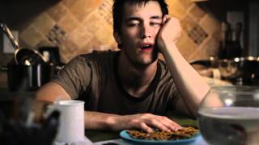
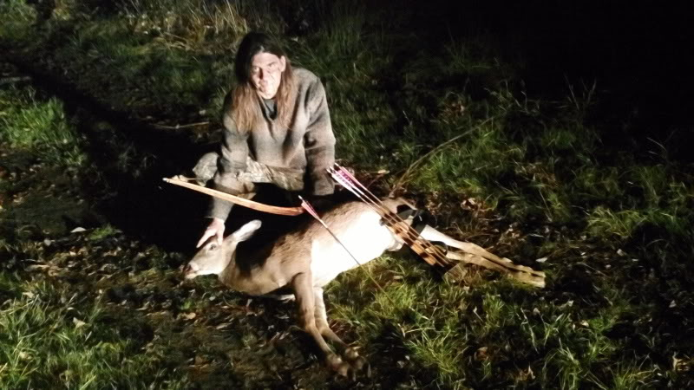
Proverbs 26:15 The lazy man buries his hand in the bowl; It wearies him to bring it back to his mouth.
Proverbs 12:27 The lazy man does not roast what he took in hunting,

Slide 20
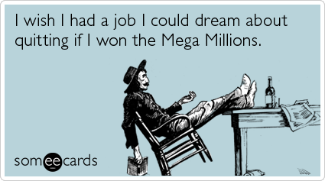
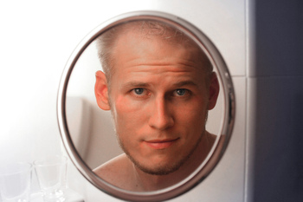
Proverbs 13:4 The soul of a lazy man desires, and has nothing;
Proverbs 26:16 The lazy man is wiser in his own eyes Than seven men who can answer sensibly.
I wish I had some money.

Slide 21
Proverbs 6:4 Give no sleep to your eyes, Nor slumber to your eyelids. 5 Deliver yourself like a gazelle from the hand of the hunter, And like a bird from the hand of the fowler. 6 Go to the ant, you sluggard! Consider her ways and be wise, 7 Which, having no captain, Overseer or ruler, 8 Provides her supplies in the summer, And gathers her food in the harvest. 9 How long will you slumber, O sluggard? When will you rise from your sleep? 10 A little sleep, a little slumber, A little folding of the hands to sleep –

Slide 22
The Ant and the Grasshopper
IN a field one summer’s day a Grasshopper was hopping about, chirping and singing to its heart’s content. An Ant passed by, bearing along with great toil an ear of corn he was taking to the nest.
“Why not come and chat with me,” said the Grasshopper, “instead of toiling and moiling in that way?”
“I am helping to lay up food for the winter,” said the Ant, “and recommend you to do the same.”

Slide 23
“Why bother about winter?” said the Grasshopper; “we have got plenty of food at present.” But the Ant went on its way and continued its toil. When the winter came the Grasshopper had no food, and found itself dying of hunger, while it saw the ants distributing every day corn and grain from the stores they had collected in the summer. Then the Grasshopper knew:
“IT IS BEST TO PREPARE FOR THE DAYS OF NECESSITY.”

Slide 24
Proverbs 22:29 Do you see a man who excels in his work? He will stand before kings; He will not stand before unknown men.

Slide 25
Proverbs 10:4 He who has a slack hand becomes poor, But the hand of the diligent makes rich.

Slide 26
Proverbs 12:24 The hand of the diligent will rule, But the lazy man will be put to forced labor.

Slide 27
Proverbs 12:27 The lazy man does not roast what he took in hunting, But diligence is man's precious possession.

Slide 28
Matthew 5:16 "Let your light so shine before men, that they may see your good works and glorify your Father in heaven.

Slide 29
1 Corinthians 15:58 Therefore, my beloved brethren, be steadfast, immovable, always abounding in the work of the Lord, knowing that your labor is not in vain in the Lord.

