Slide 1
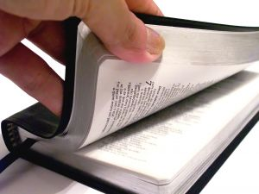
JUDGED BY THE WORD

Slide 2
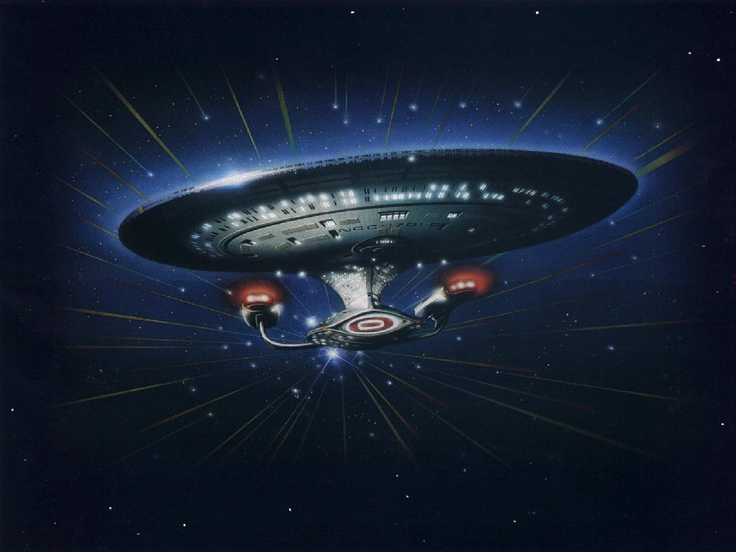

Slide 3
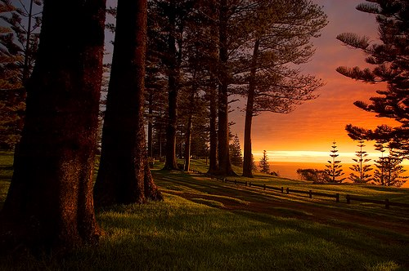
ESV 2 Timothy 3:16 All Scripture is breathed out by God and profitable for teaching, for reproof, for correction, and for training in righteousness, ¹⁷ that the man of God may be competent, equipped for every good work.

Slide 4
John 8:32 "And you shall know the truth, and the truth shall make you free."

Slide 5
John 7:16 Jesus answered them and said, "My doctrine is not Mine, but His who sent Me.

Slide 6
2 John 1:9 Whoever transgresses and does not abide in the doctrine of Christ does not have God. He who abides in the doctrine of Christ has both the Father and the Son. ¹⁰ If anyone comes to you and does not bring this doctrine, do not receive him into your house nor greet him;

Slide 7
Hebrews 4:12 For the word of God is living and powerful, and sharper than any two-edged sword, piercing even to the division of soul and spirit, and of joints and marrow, and is a discerner of the thoughts and intents of the heart.

Slide 8
Matthew 24:35 "Heaven and earth will pass away, but My words will by no means pass away.

Slide 9
^{KJV} 2 Timothy 2:15 Study to shew thyself approved unto God, a workman that needeth not to be ashamed, rightly dividing the word of truth.

Slide 10
2 Peter 3:18 but grow in the grace and knowledge of our Lord and Savior Jesus Christ.

Slide 11
Acts 24:24 And after some days, when Felix came with his wife Drusilla, who was Jewish, he sent for Paul and heard him concerning the faith in Christ. ²⁵ Now as he reasoned about righteousness, self-control, and the judgment to come, Felix was afraid and answered, "Go away for now; when I have a convenient time I will call for you."

Slide 12
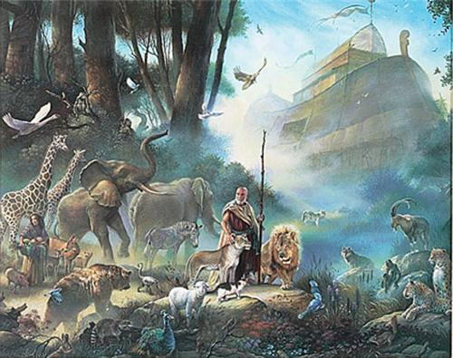
Matthew 24:36 " But of that day and hour no one knows, not even the angels of heaven, but My Father only. ³⁷ "But as the days of Noah were, so also will the coming of the Son of Man be. ³⁸ "For as in
the days before the flood, they were eating and drinking, marrying and giving in marriage, until the day that Noah entered the ark, ³⁹ "and did not know until the flood came and took them all away, so also will the coming of the Son of Man be.

Slide 13
John 14:1 "Let not your heart be troubled; you believe in God, believe also in Me. ² "In My Father's house are many mansions; if it were not so, I would have told you. I go to prepare a place for you. ³ "And if I go and prepare a place for you, I will come again and receive you to Myself; that where I am, there you may be also.

Slide 14
2 Timothy 4:7 I have fought the good fight, I have finished the race, I have kept the faith. ⁸ Finally, there is laid up for me the crown of righteousness, which the Lord, the righteous Judge, will give to me on that Day, and not to me only but also to all who have loved His appearing.

Slide 15
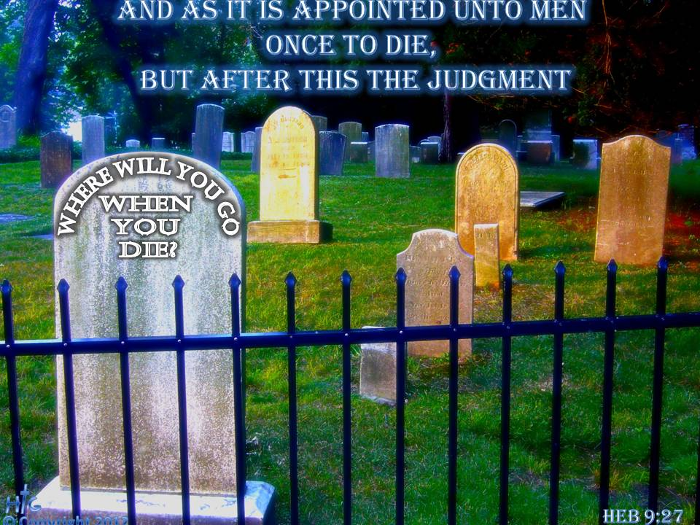
Hebrews 9:27 And as it is appointed for men to die once, but after this the judgment, ²⁸ so Christ was offered once to bear the sins of many. To those who eagerly wait for Him He will appear a second time, apart from sin, for salvation.

Slide 16
Acts 1:9 Now when He had spoken these things, while they watched, He was taken up, and a cloud received Him out of their sight. ¹⁰ And while they looked steadfastly toward heaven as He went up, behold, two men stood by them in white apparel, ¹¹ who also said, "Men of Galilee, why do you stand gazing up into heaven? This same Jesus, who was taken up from you into heaven, will so come in like manner as you saw Him go into heaven."

Slide 17
1 Thessalonians 4:16 For the Lord Himself will descend from heaven with a shout, with the voice of an archangel, and with the trumpet of God. And the dead in Christ will rise first. ¹⁷ Then we who are alive and remain shall be caught up together with them in the clouds to meet the Lord in the air. And thus we shall always be with the Lord. ¹⁸ Therefore comfort one another with these words.

Slide 18
John 17:4 "I have glorified You on the earth. I have finished the work which You have given Me to do.

Slide 19
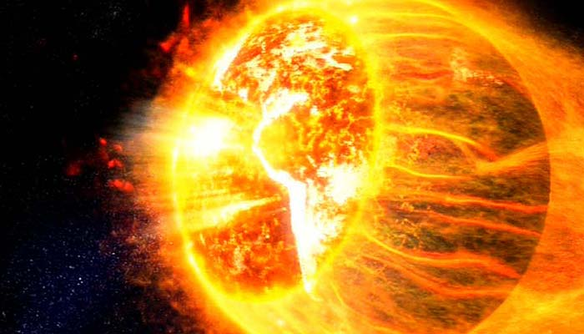
2 Peter 3:10 But the day of the Lord will come as a thief in the night, in which the heavens will pass away with a great noise, and the elements will melt with fervent
heat; both the earth and the works that are in it will be burned up. ¹¹ Therefore, since all these things will be dissolved, what manner of persons ought you to be in holy conduct and godliness, ¹² looking for and hastening the coming of the day of God, because of which the heavens will be dissolved, being on fire, and the elements will melt with fervent heat?

Slide 20
John 5:28 "Do not marvel at this; for the hour is coming in which all who are in the graves will hear His voice ²⁹ "and come forth -- those who have done good, to the resurrection of life, and those who have done evil, to the resurrection of condemnation.

Slide 21
2 Corinthians 5:10 For we must all appear before the judgment seat of Christ, that each one may receive the things done in the body, according to what he has done, whether good or bad.

Slide 22
Matthew 25:31 " When the Son of Man comes in His glory, and all the holy angels with Him, then He will sit on the throne of His glory. ³² "All the nations will be gathered before Him, and He will separate them one from another, as a shepherd divides his sheep from the goats. ³³ "And He will set the sheep on His right hand, but the goats on the left. ³⁴ "Then the King will say to those on His right hand, 'Come, you blessed of My Father, inherit the kingdom prepared for you from the foundation of the world: ³⁵ 'for I was hungry and you gave Me food; I was thirsty and you gave Me drink; I was a stranger and you took Me in;

Slide 23
³⁶ 'I was naked and you clothed Me; I was sick and you visited Me; I was in prison and you came to Me.' ³⁷ "Then the righteous will answer Him, saying, 'Lord, when did we see You hungry and feed You, or thirsty and give You drink? ³⁸ 'When did we see You a stranger and take You in, or naked and clothe You? ³⁹ 'Or when did we see You sick, or in prison, and come to You?' ⁴⁰ "And the King will answer and say to them, 'Assuredly, I say to you, inasmuch as you did it to one of the least of these My brethren, you did it to Me.' ⁴¹ "Then He will also say to those on the left hand, 'Depart from Me, you cursed, into the everlasting fire prepared for the devil and his angels:

Slide 24
⁴² 'for I was hungry and you gave Me no food; I was thirsty and you gave Me no drink; ⁴³ 'I was a stranger and you did not take Me in, naked and you did not clothe Me, sick and in prison and you did not visit Me.' ⁴⁴ "Then they also will answer Him, saying, 'Lord, when did we see You hungry or thirsty or a stranger or naked or sick or in prison, and did not minister to You?' ⁴⁵ "Then He will answer them, saying, 'Assuredly, I say to you, inasmuch as you did not do it to one of the least of these, you did not do it to Me.' ⁴⁶ "And these will go away into everlasting punishment, but the righteous into eternal life."

Slide 25
Acts 17:30 "Truly, these times of ignorance God overlooked, but now commands all men everywhere to repent, ³¹ "because He has appointed a day on which He will judge the world in righteousness by the Man whom He has ordained. He has given assurance of this to all by raising Him from the dead."

Slide 26
John 12:48 "He who rejects Me, and does not receive My words, has that which judges him -- the word that I have spoken will judge him in the last day.
Revelation 20:12 And I saw the dead, small and great, standing before God, and books were opened. And another book was opened, which is the Book of Life. And the dead were judged according to their works, by the things which were written in the books.

Slide 27
Matthew 25:1 "Then the kingdom of heaven shall be likened to ten virgins who took their lamps and went out to meet the bridegroom. ² "Now five of them were wise, and five were foolish. ³ "Those who were foolish took their lamps and took no oil with them, ⁴ "but the wise took oil in their vessels with their lamps. ⁵ "But while the bridegroom was delayed, they all slumbered and slept. ⁶ "And at midnight a cry was heard: 'Behold, the bridegroom is coming; go out to meet him!' ⁷ "Then all those virgins arose and trimmed their lamps. ⁸ "And the foolish said to the wise, 'Give us some of your oil, for our lamps are going out

Slide 28
.' ⁹ "But the wise answered, saying, 'No, lest there should not be enough for us and you; but go rather to those who sell, and buy for yourselves.' ¹⁰ "And while they went to buy, the bridegroom came, and those who were ready went in with him to the wedding; and the door was shut. ¹¹ "Afterward the other virgins came also, saying, 'Lord, Lord, open to us!' ¹² "But he answered and said, 'Assuredly, I say to you, I do not know you.' ¹³ "Watch therefore, for you know neither the day nor the hour in which the Son of Man is coming.

Slide 29
Matthew 7:21 " Not everyone who says to Me, 'Lord, Lord,' shall enter the kingdom of heaven, but he who does the will of My Father in heaven.
Revelation 2:10 Be faithful until death, and I will give you the crown of life.

Slide 30
How does your life measure up to the Word of God?
Are you a walking epistle of truth or a walking epistle of the world?

Slide 31
